Slide 1
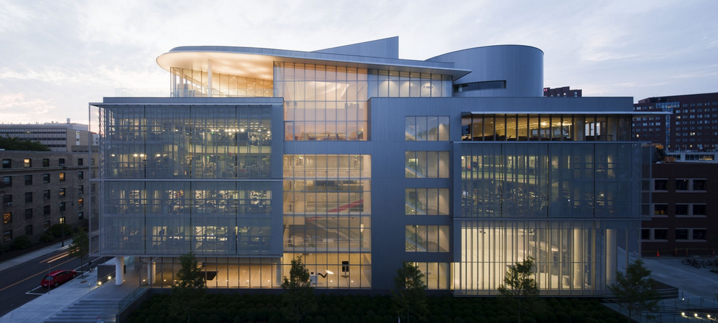
Notes:
New team members

Slide 2
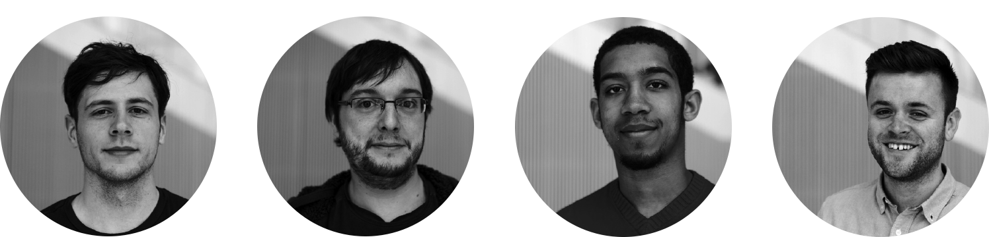

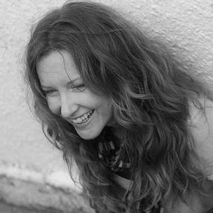
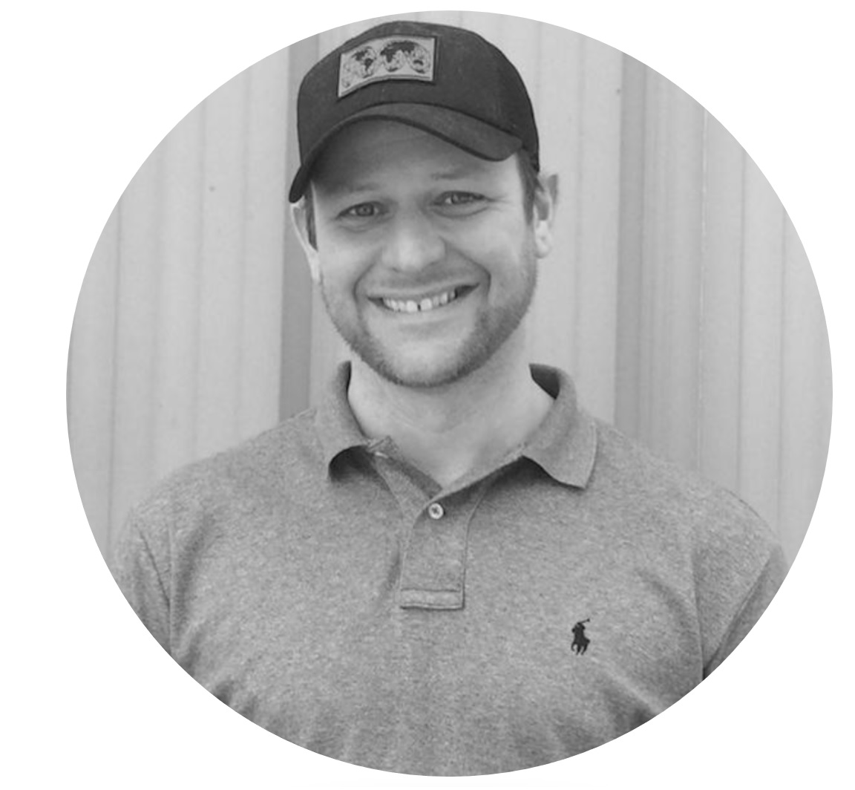
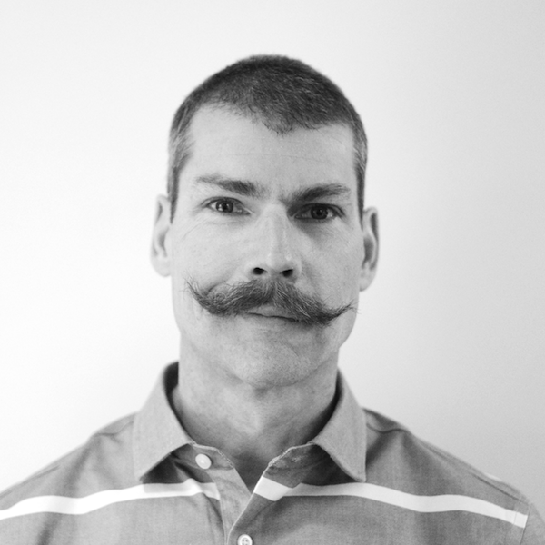

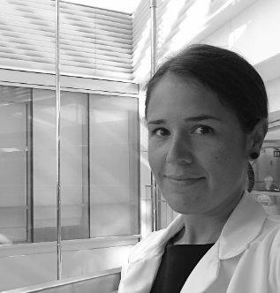

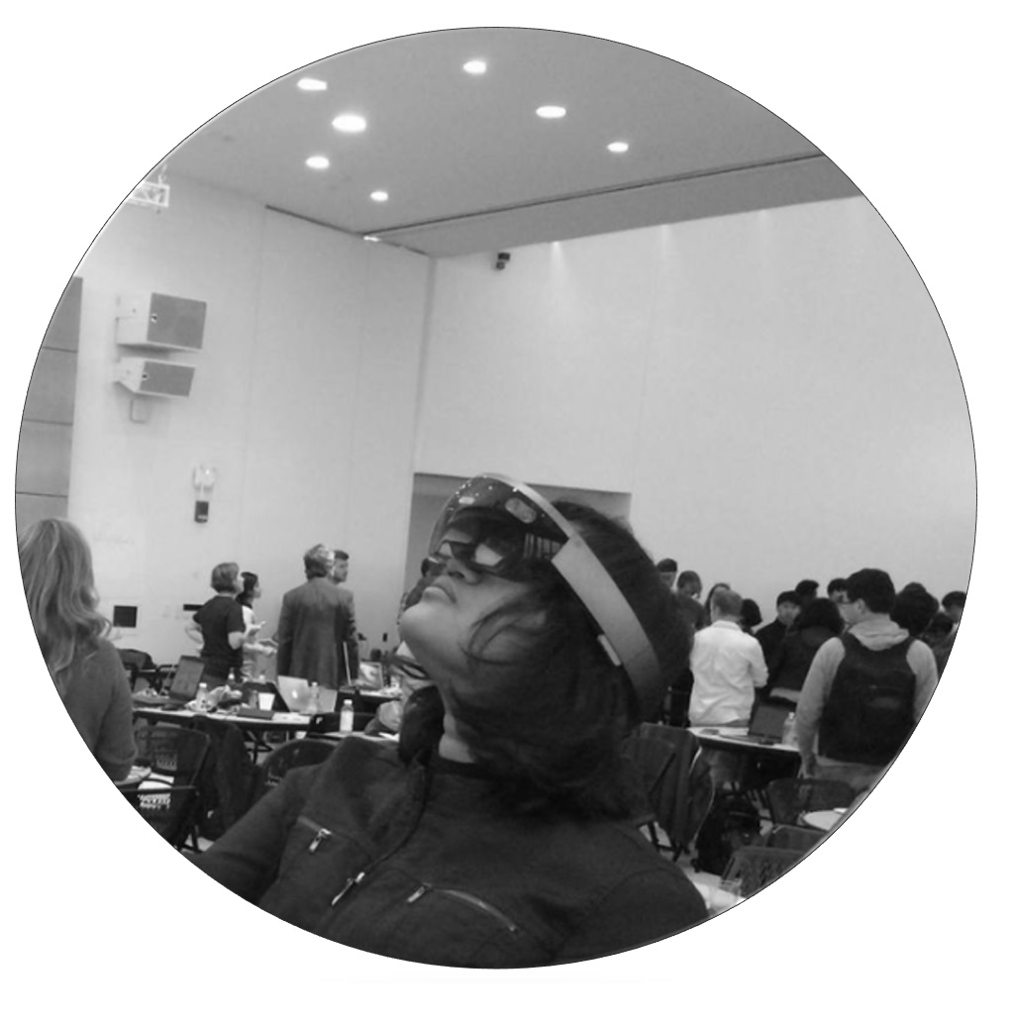


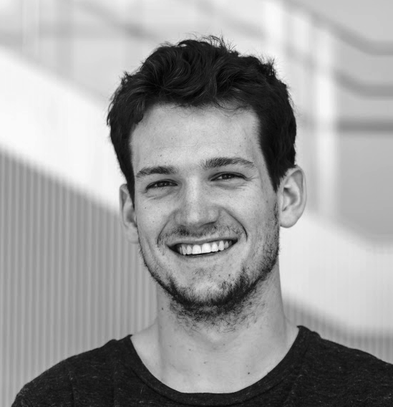




Caleb Harper
Director,
Principal Research Scientist
Hildreth England
Assistant Director
Tim Savas
Mechanical Engineer
Dan Poitrast
Mechatronic/Embedded Systems Engineer
Rob Baynes
Lead Backend Engineer
Eugene Zeleny
Mechanical Engineer/Designer
Paula Cerqueira
Special Projects Manager
Rebekah Carlson
Plant Research Assistant
Jake Rye
Special Projects Engineer
Sebastian Nowak
Project Assistant
Manvitha Ponnapati
Software Developer
Alexander Auerbach
Systems Architect
OpenAg Team
Notes:
New team members

Slide 3
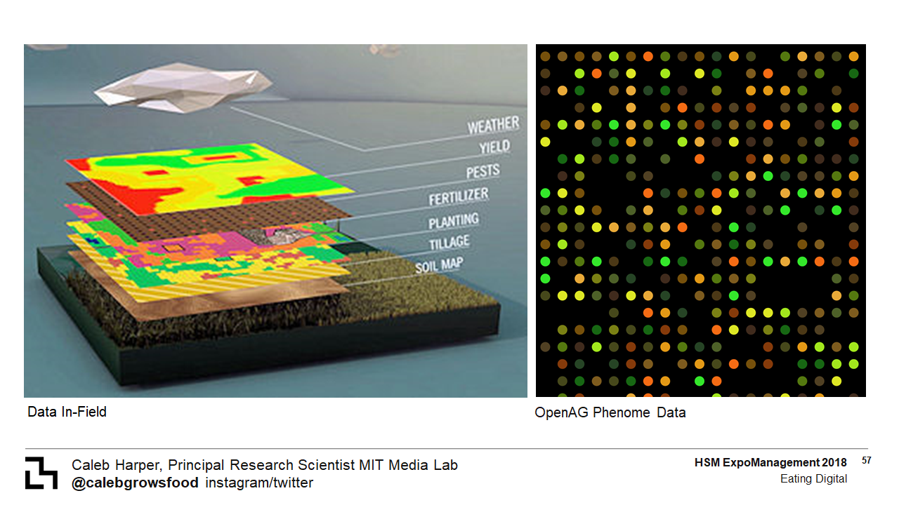
Climate Prospecting
Principles of Suitability Mapping

Slide 4
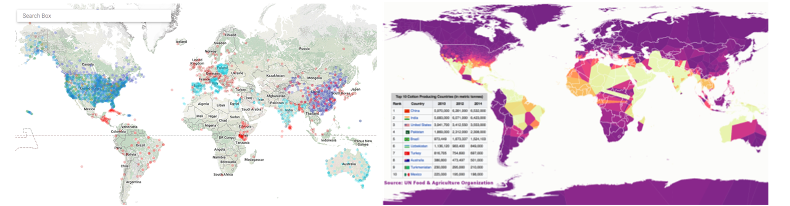
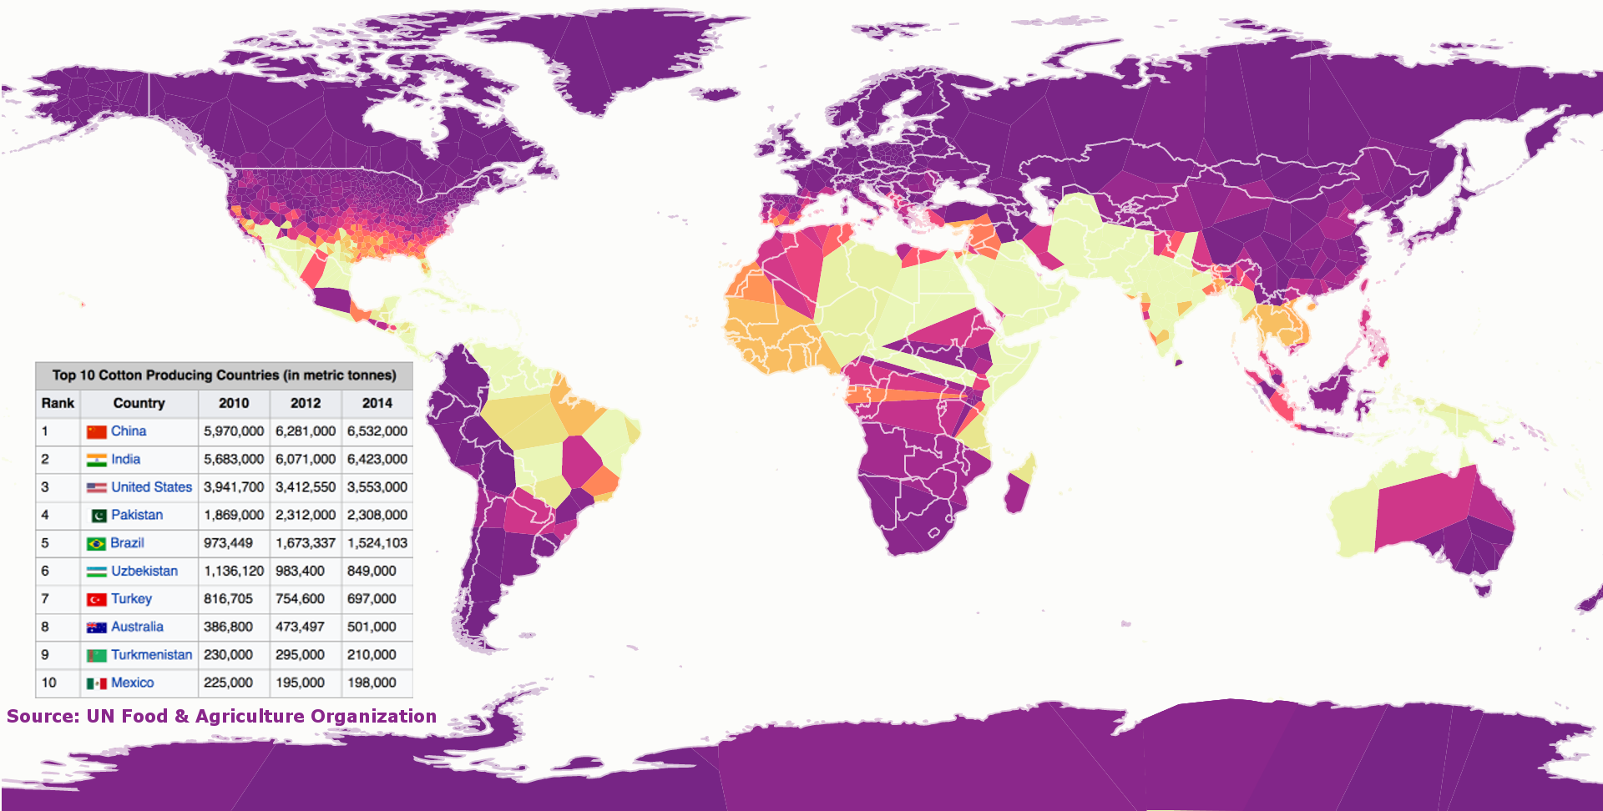
Climate Prospecting
Cf. 30 Years of Cotton Data

Slide 5
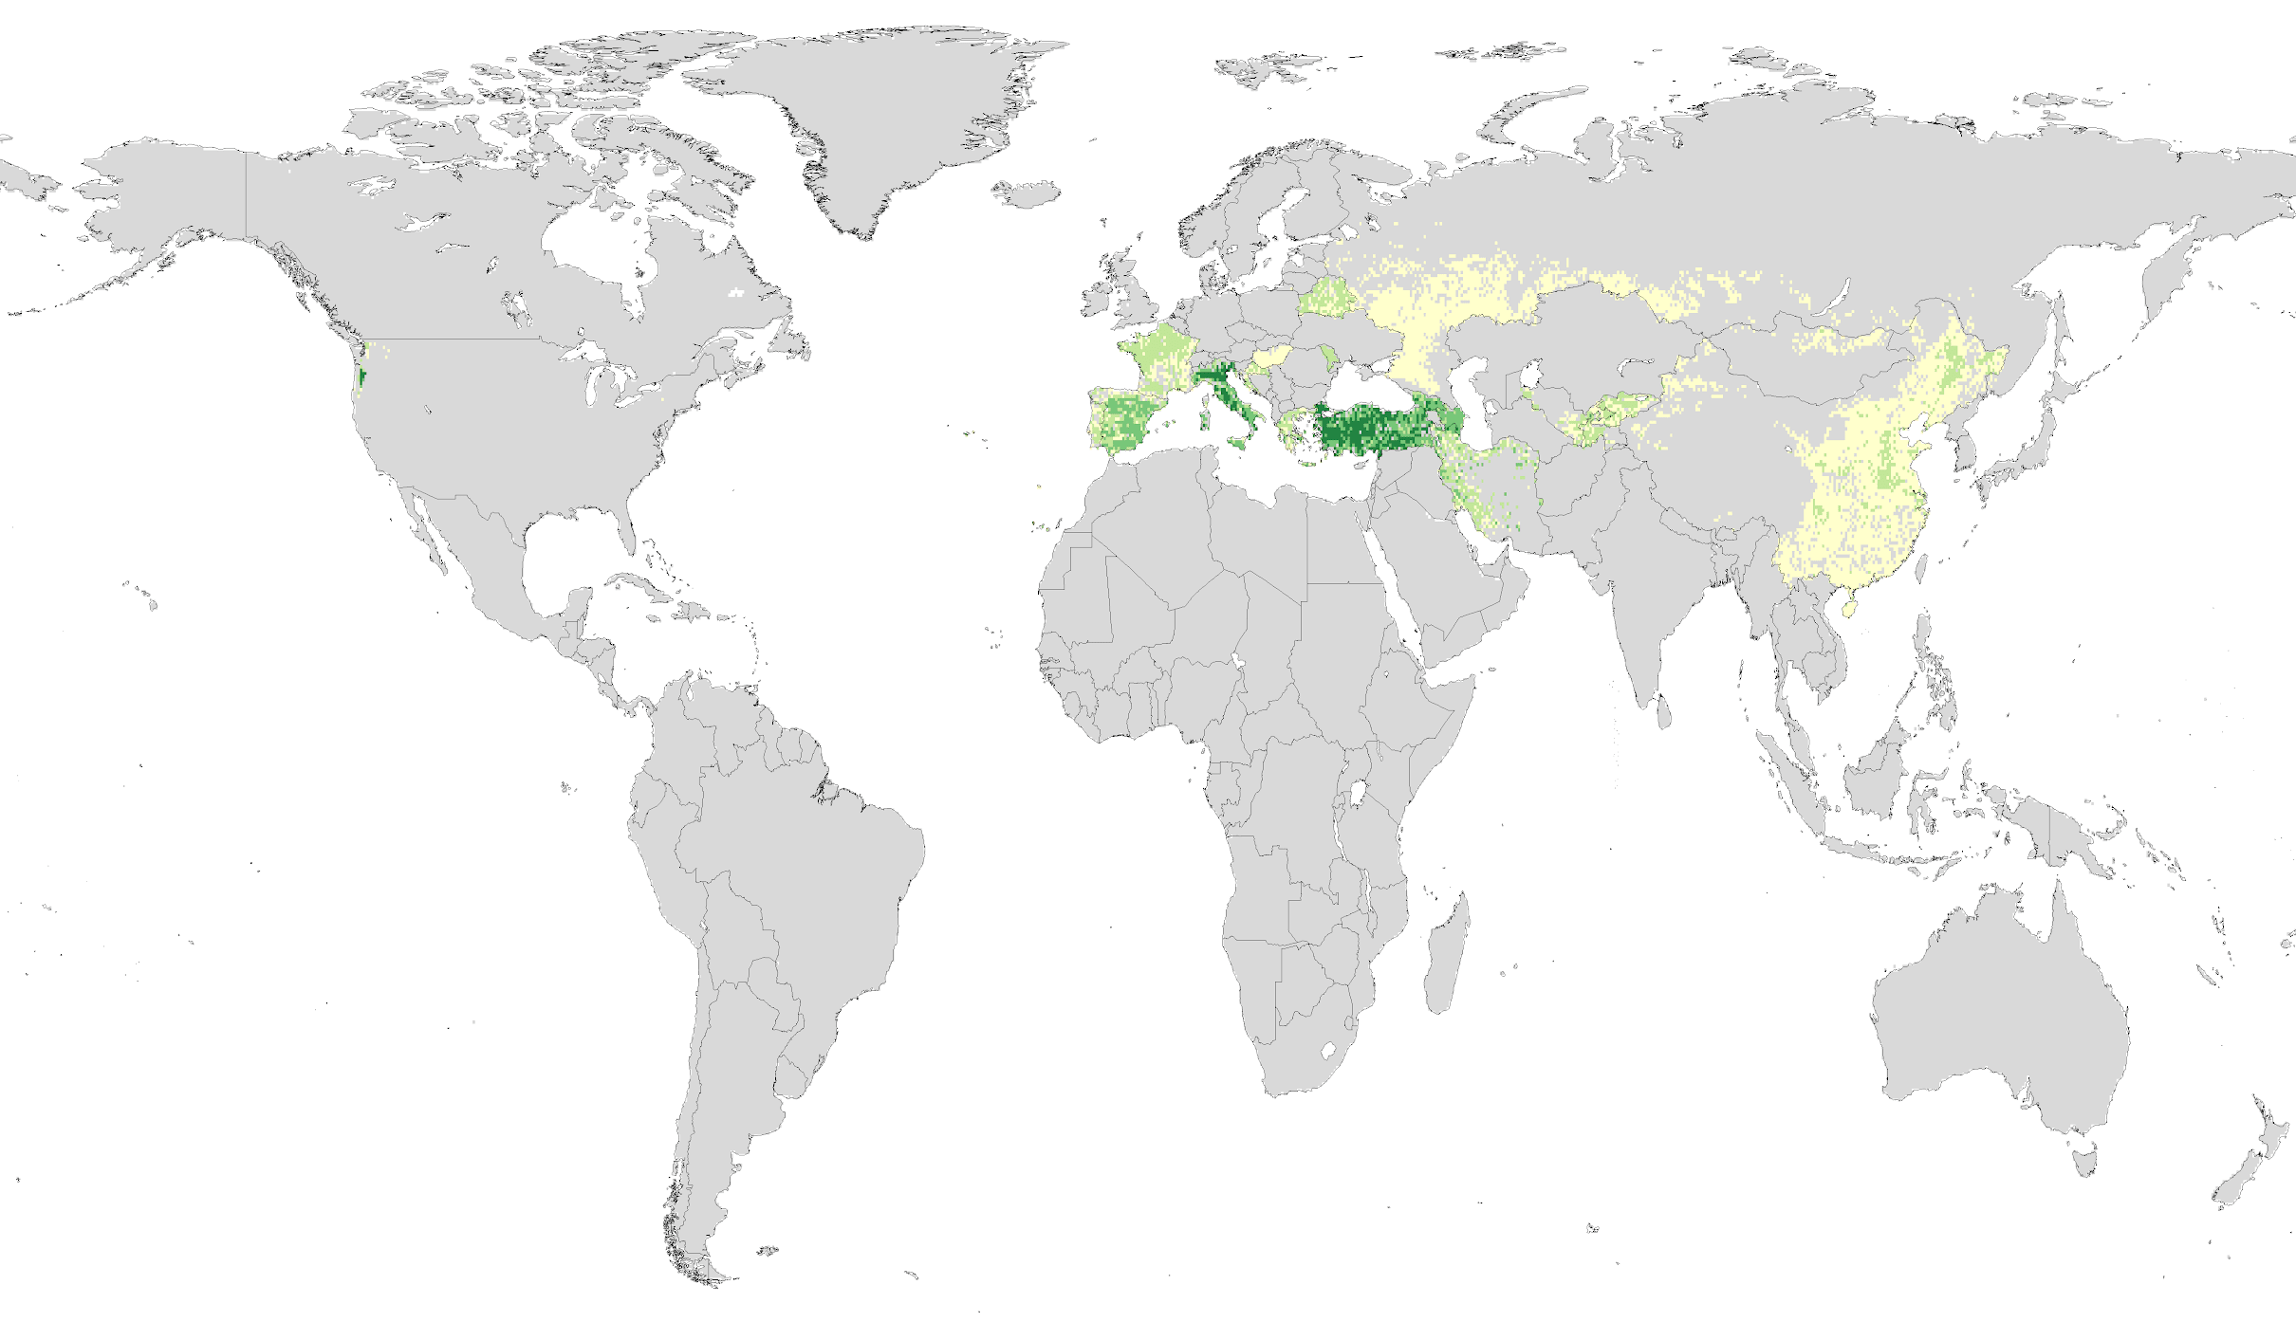
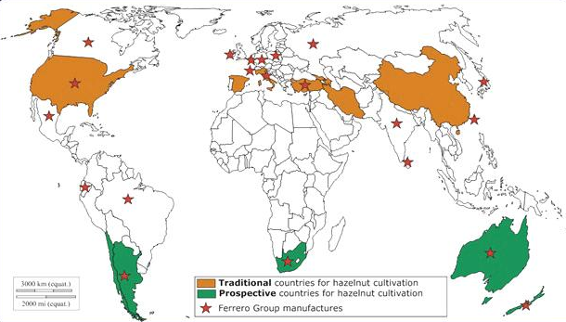
Climate Prospecting
Hazelnut Cultivation, Current vs. Prospective

Slide 6
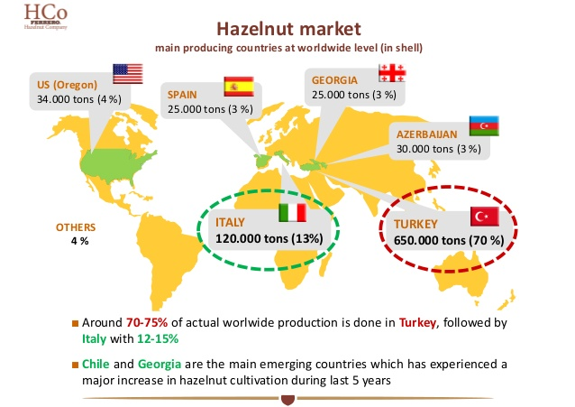
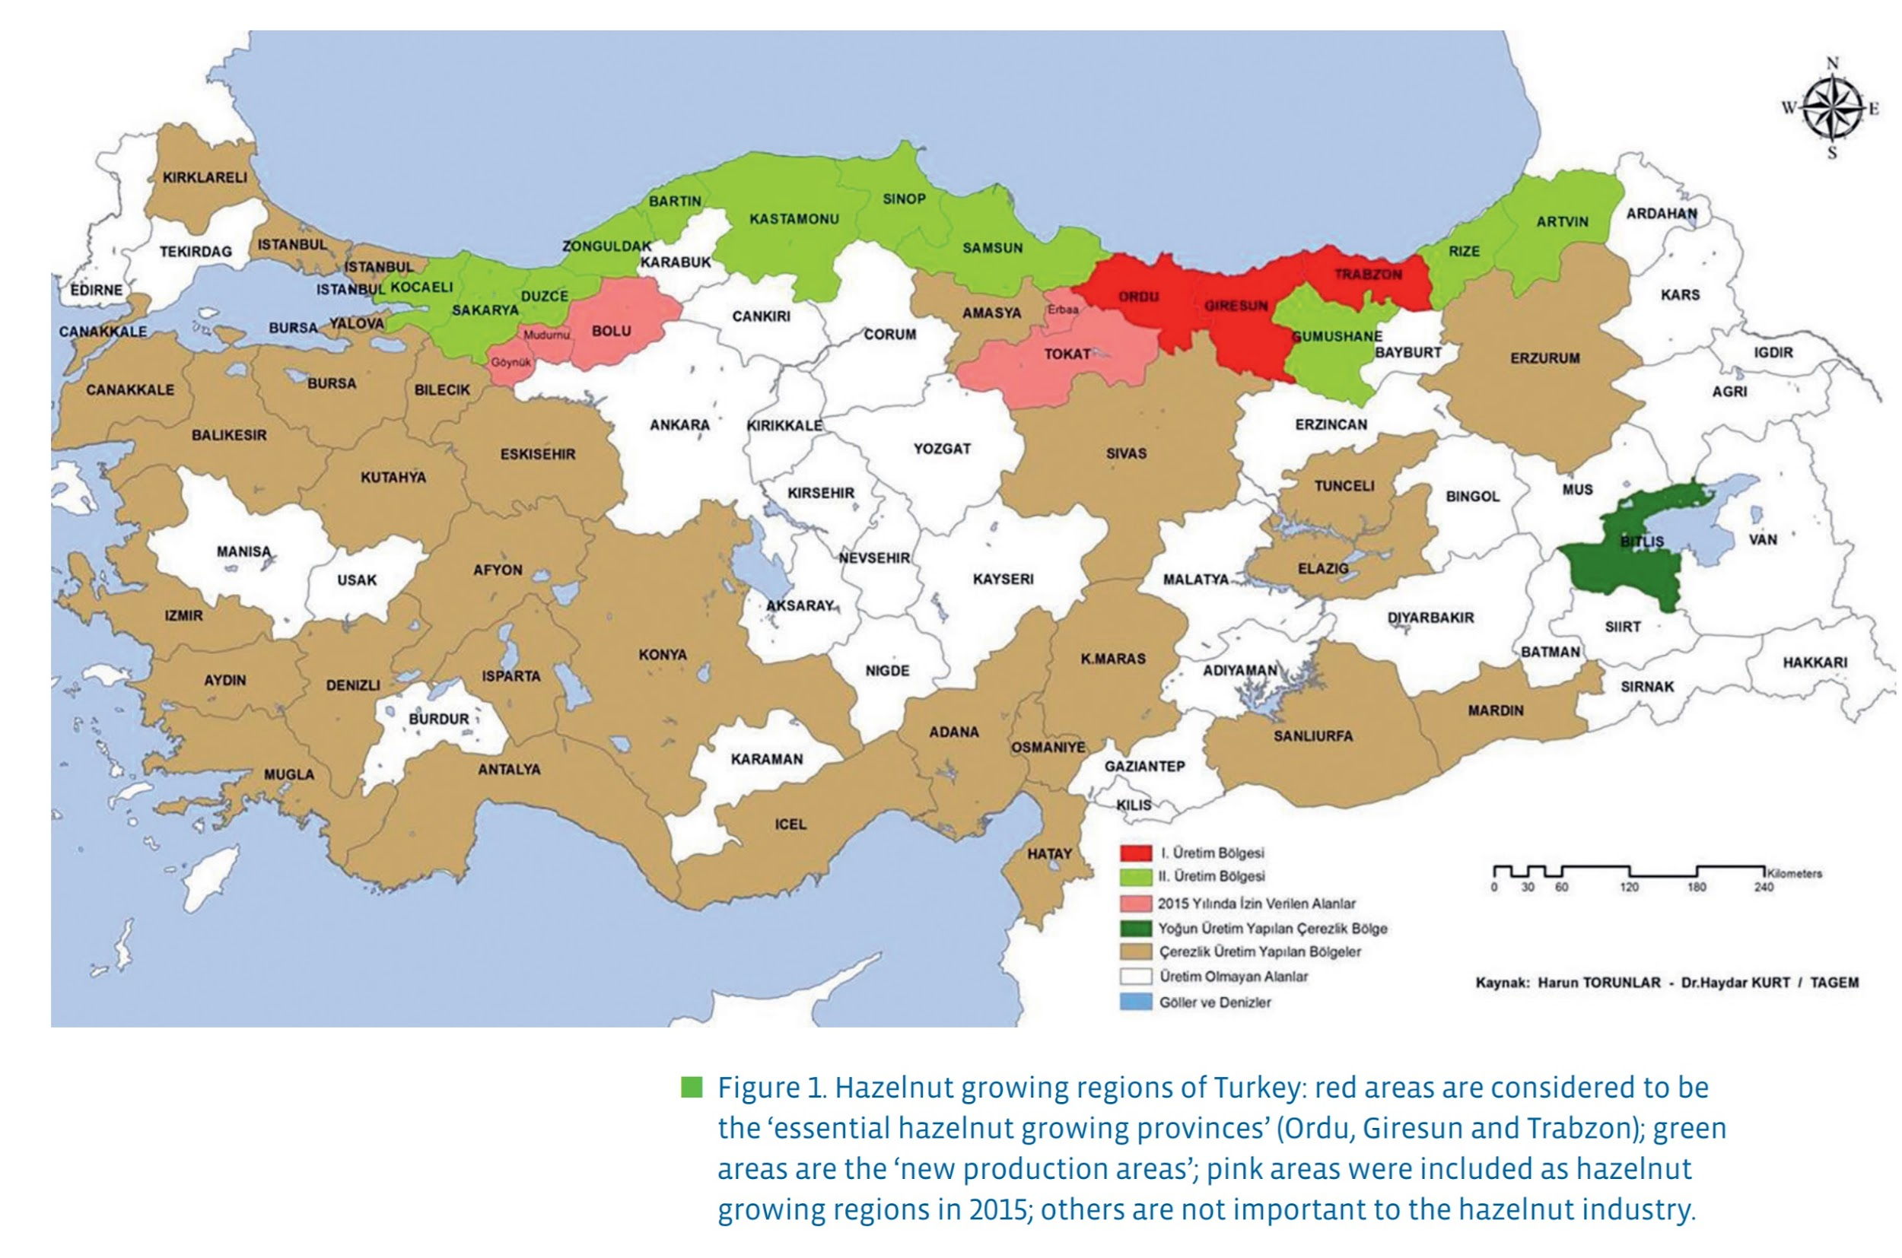
Climate Prospecting
Hazelnut Cultivation

Slide 7
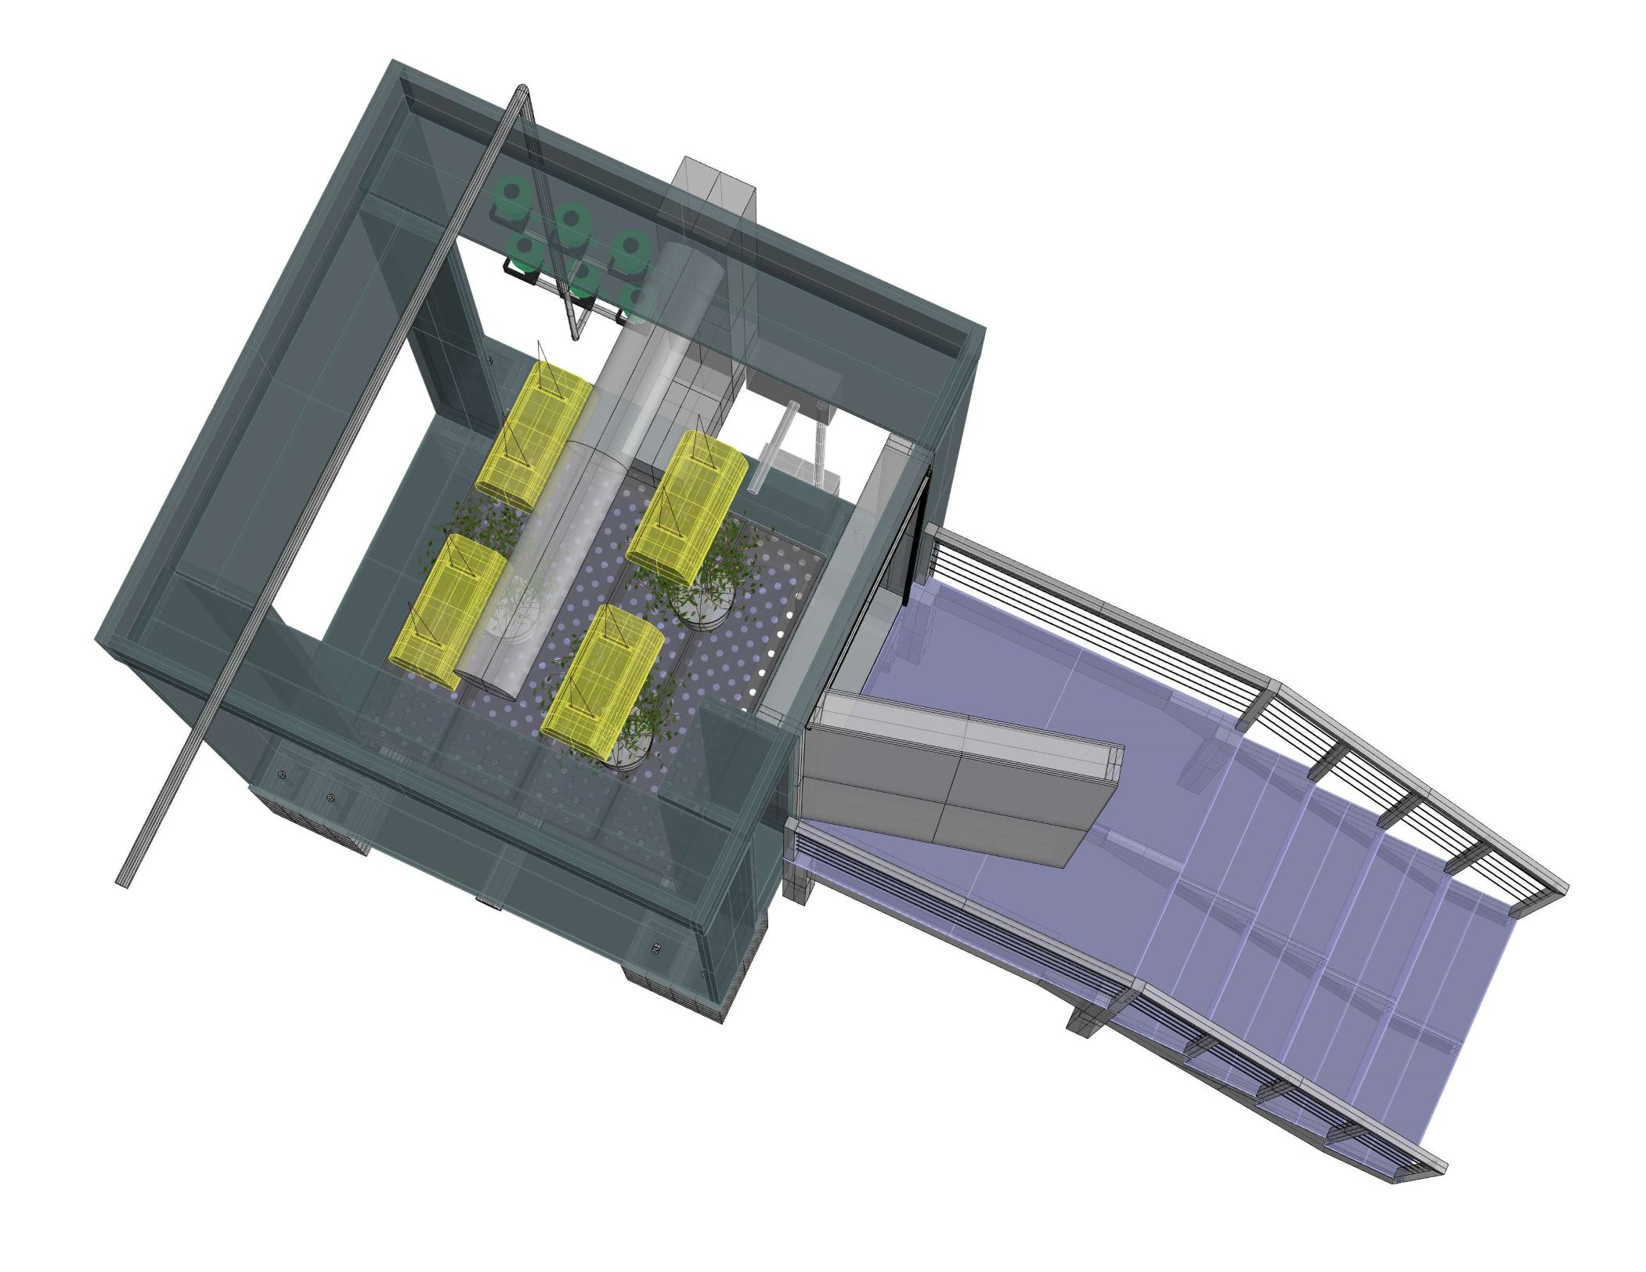
Small Tree Computer
Juvenile Tree Research

Slide 8
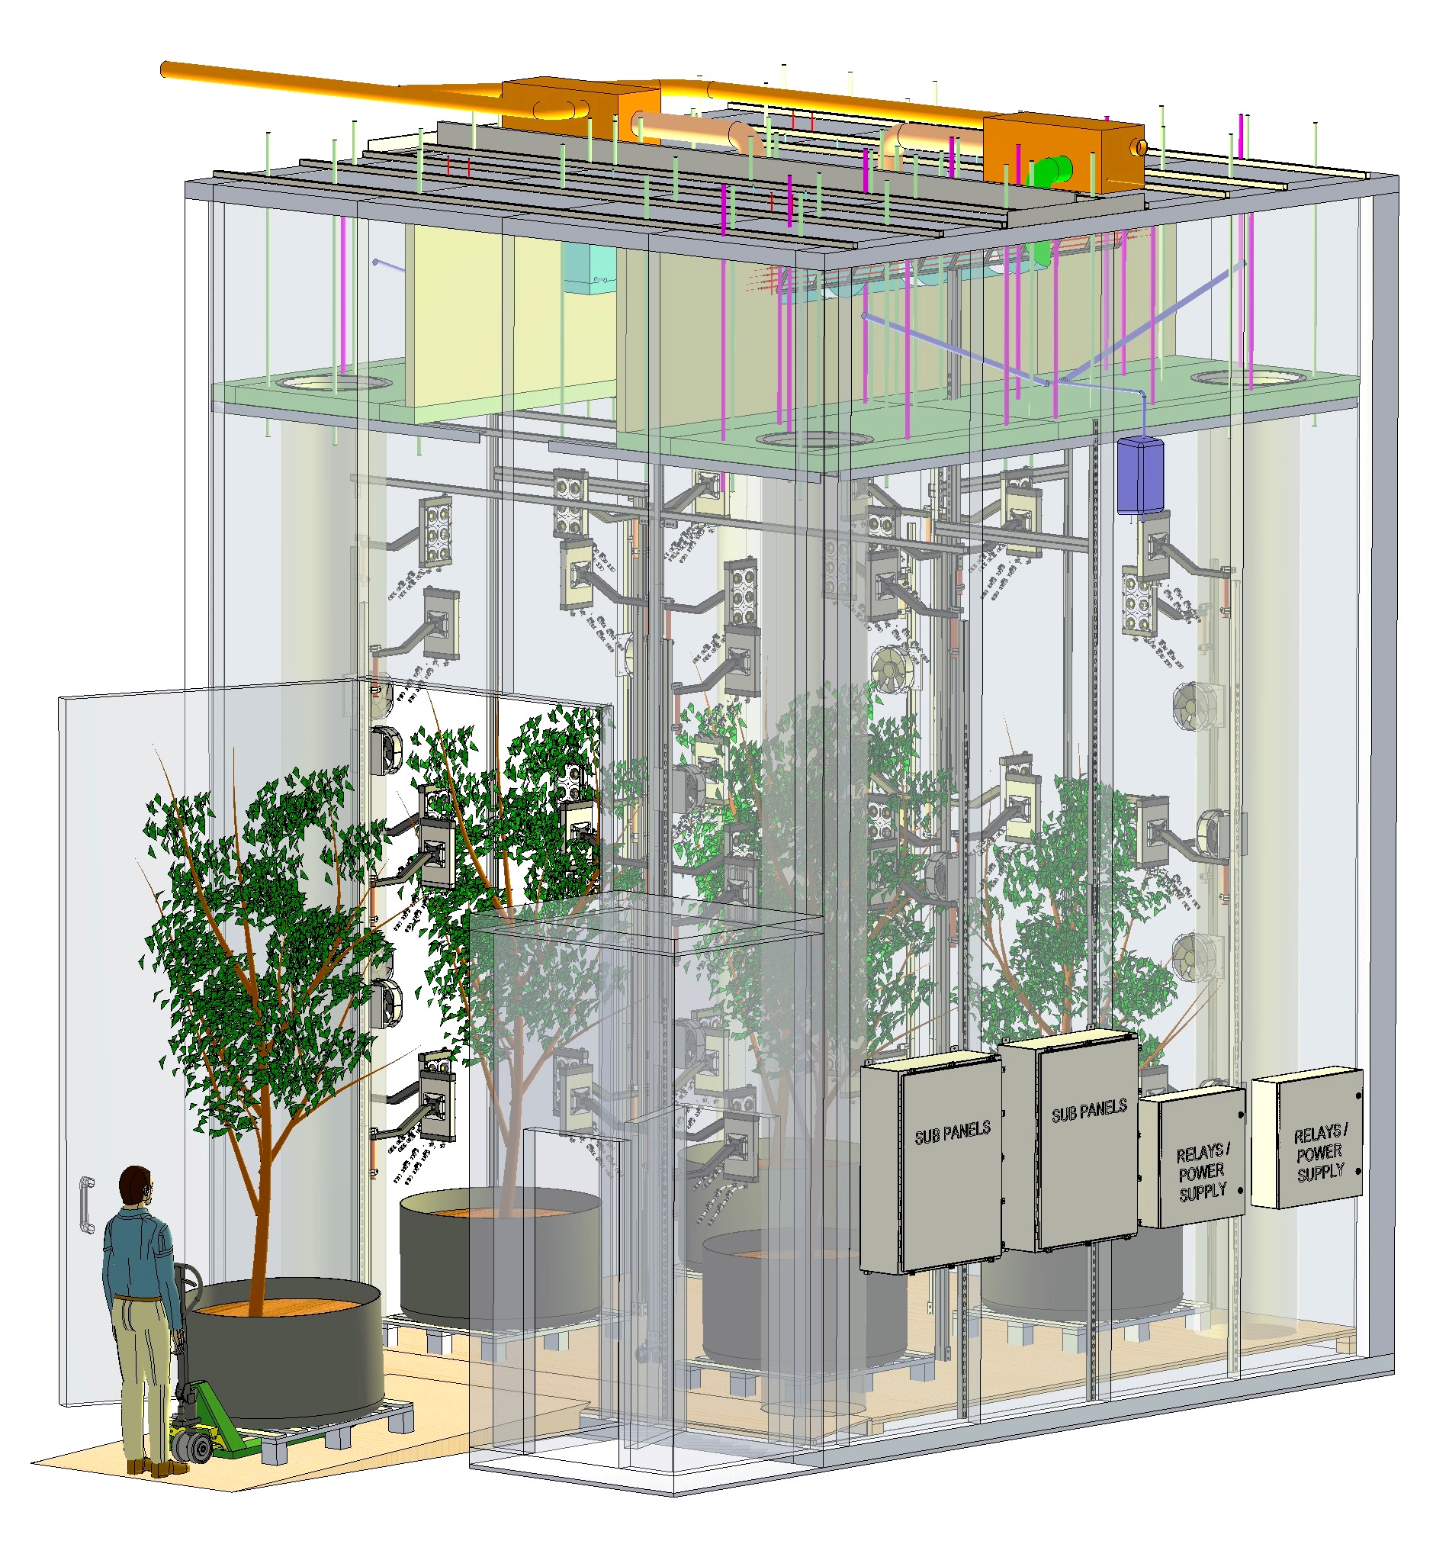

Slide 9
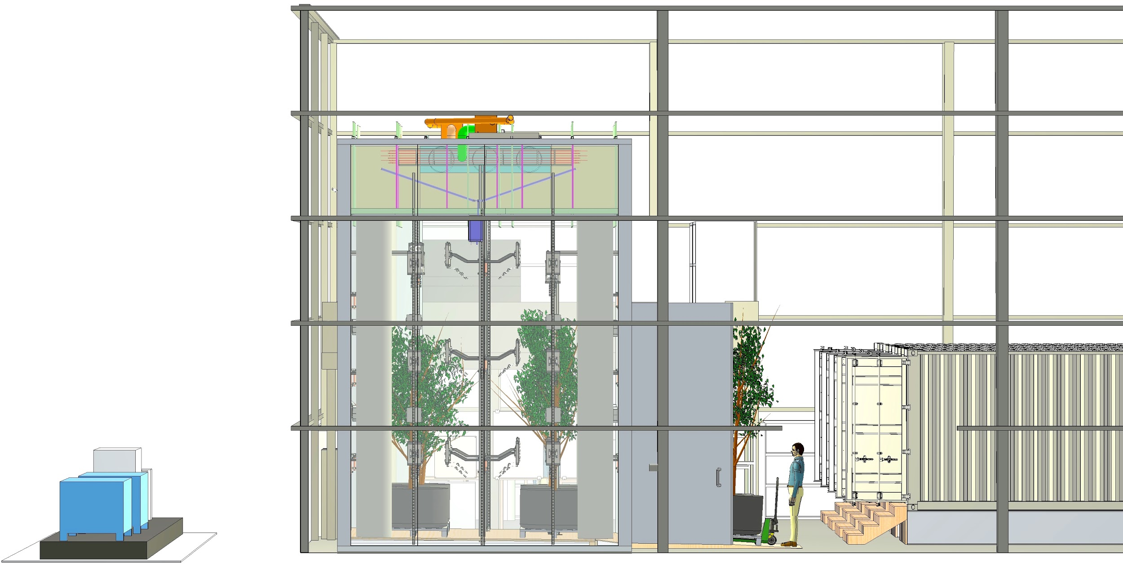
Large Tree Computer
Mature Tree Research

Slide 10
Design Specifications
Temperature Range: -35C <> +55C +/- 0.5C
Relative Humidity Range: 20-100% +/- 5%
Irradiance:
15,000,000+ Combinations
0-1800 umol/m^2/s PPFD
97% True-to-Daylight
Fertigation: Drought <> Flood
Wind: 0 <> 40 km/hr

Slide 11
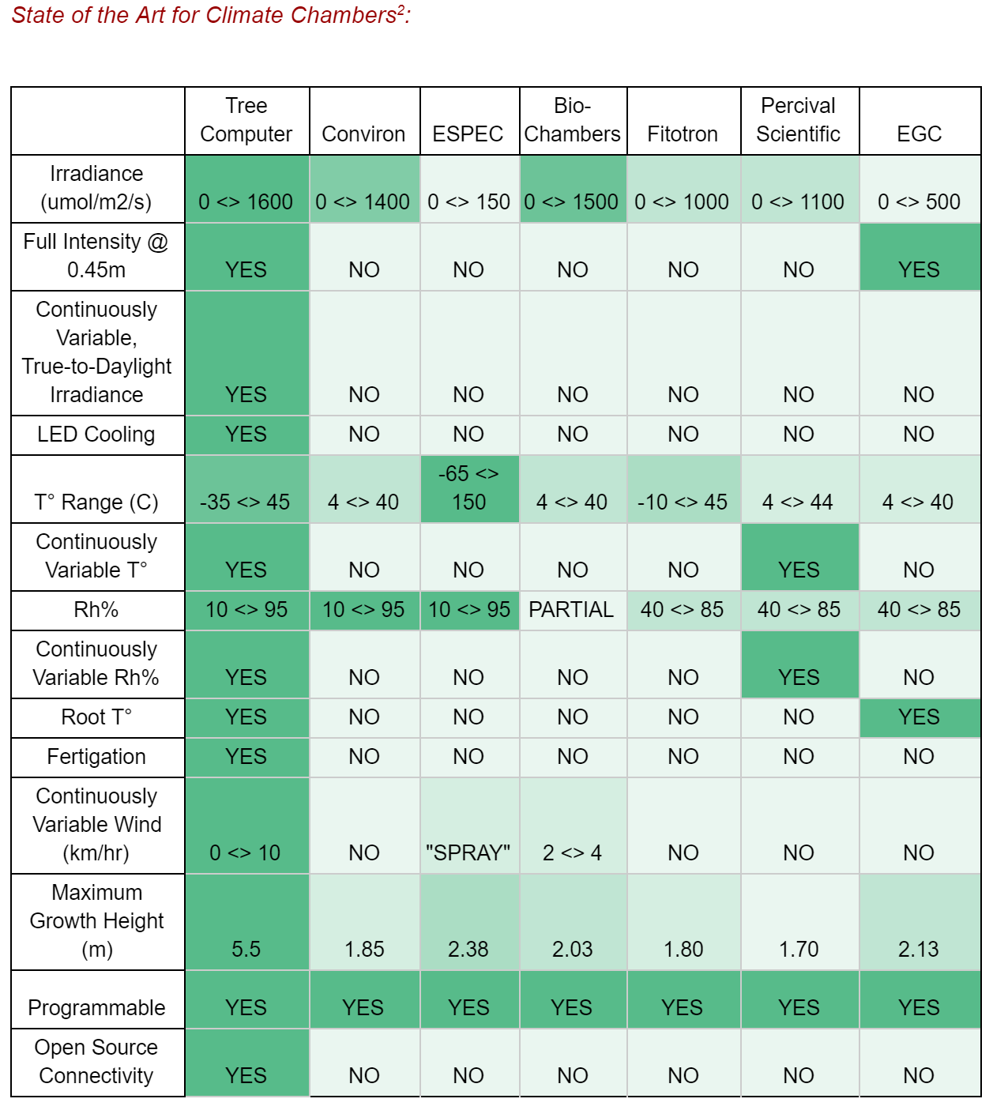
R&D
Tree Computer
Specifications

Slide 12
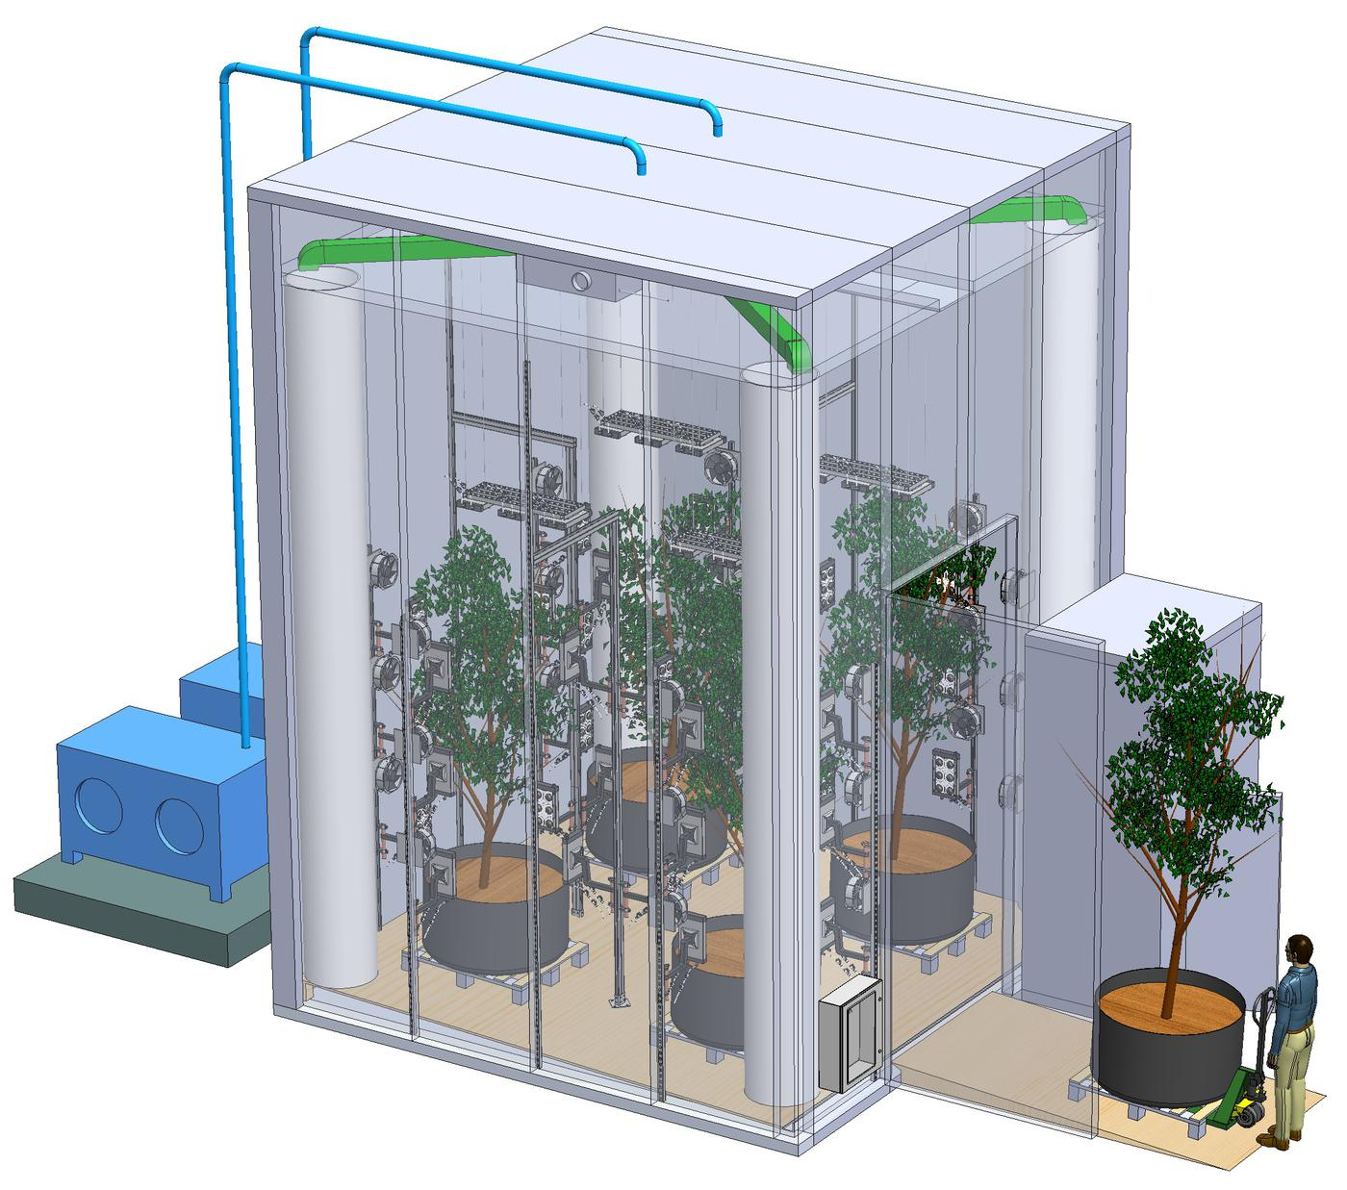
Large Hz Computer
Showing:
Plenum (air mixing chamber)
Air distribution and ductwork
LED Lighting
Fans
Potted, mature hazelnut trees
Condensing Units
“False Floor”

Slide 13
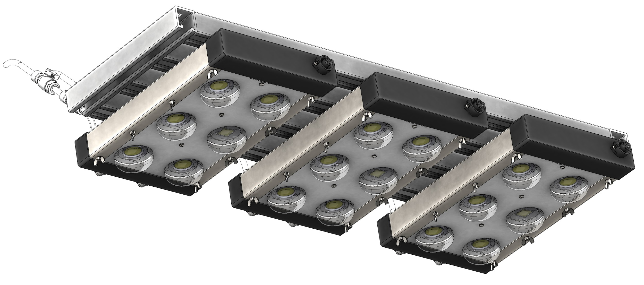
Custom OpenAg LED Fixtures (40/48 Built)
Showing:
Water cooling
Mounting system
(6) Chip-on-board LEDs &Lenses
Communications & Power Connection

Slide 14
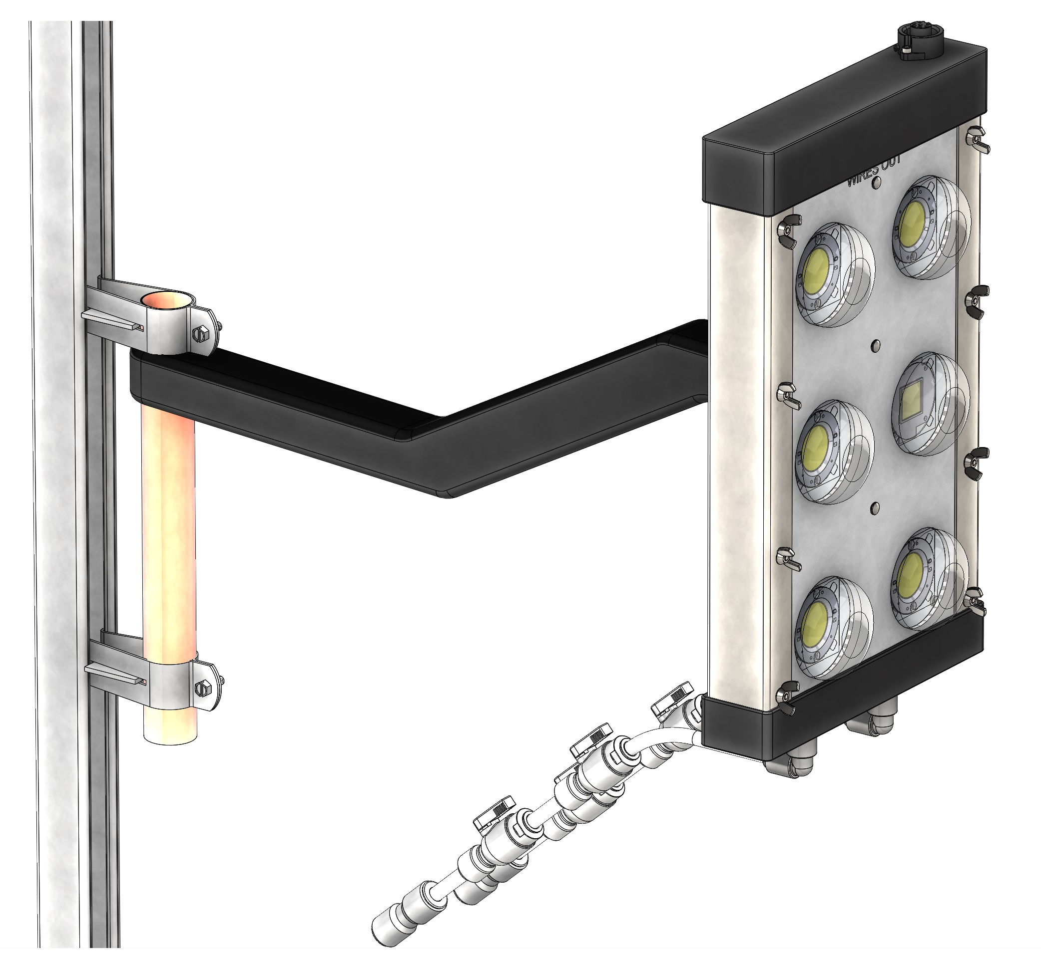
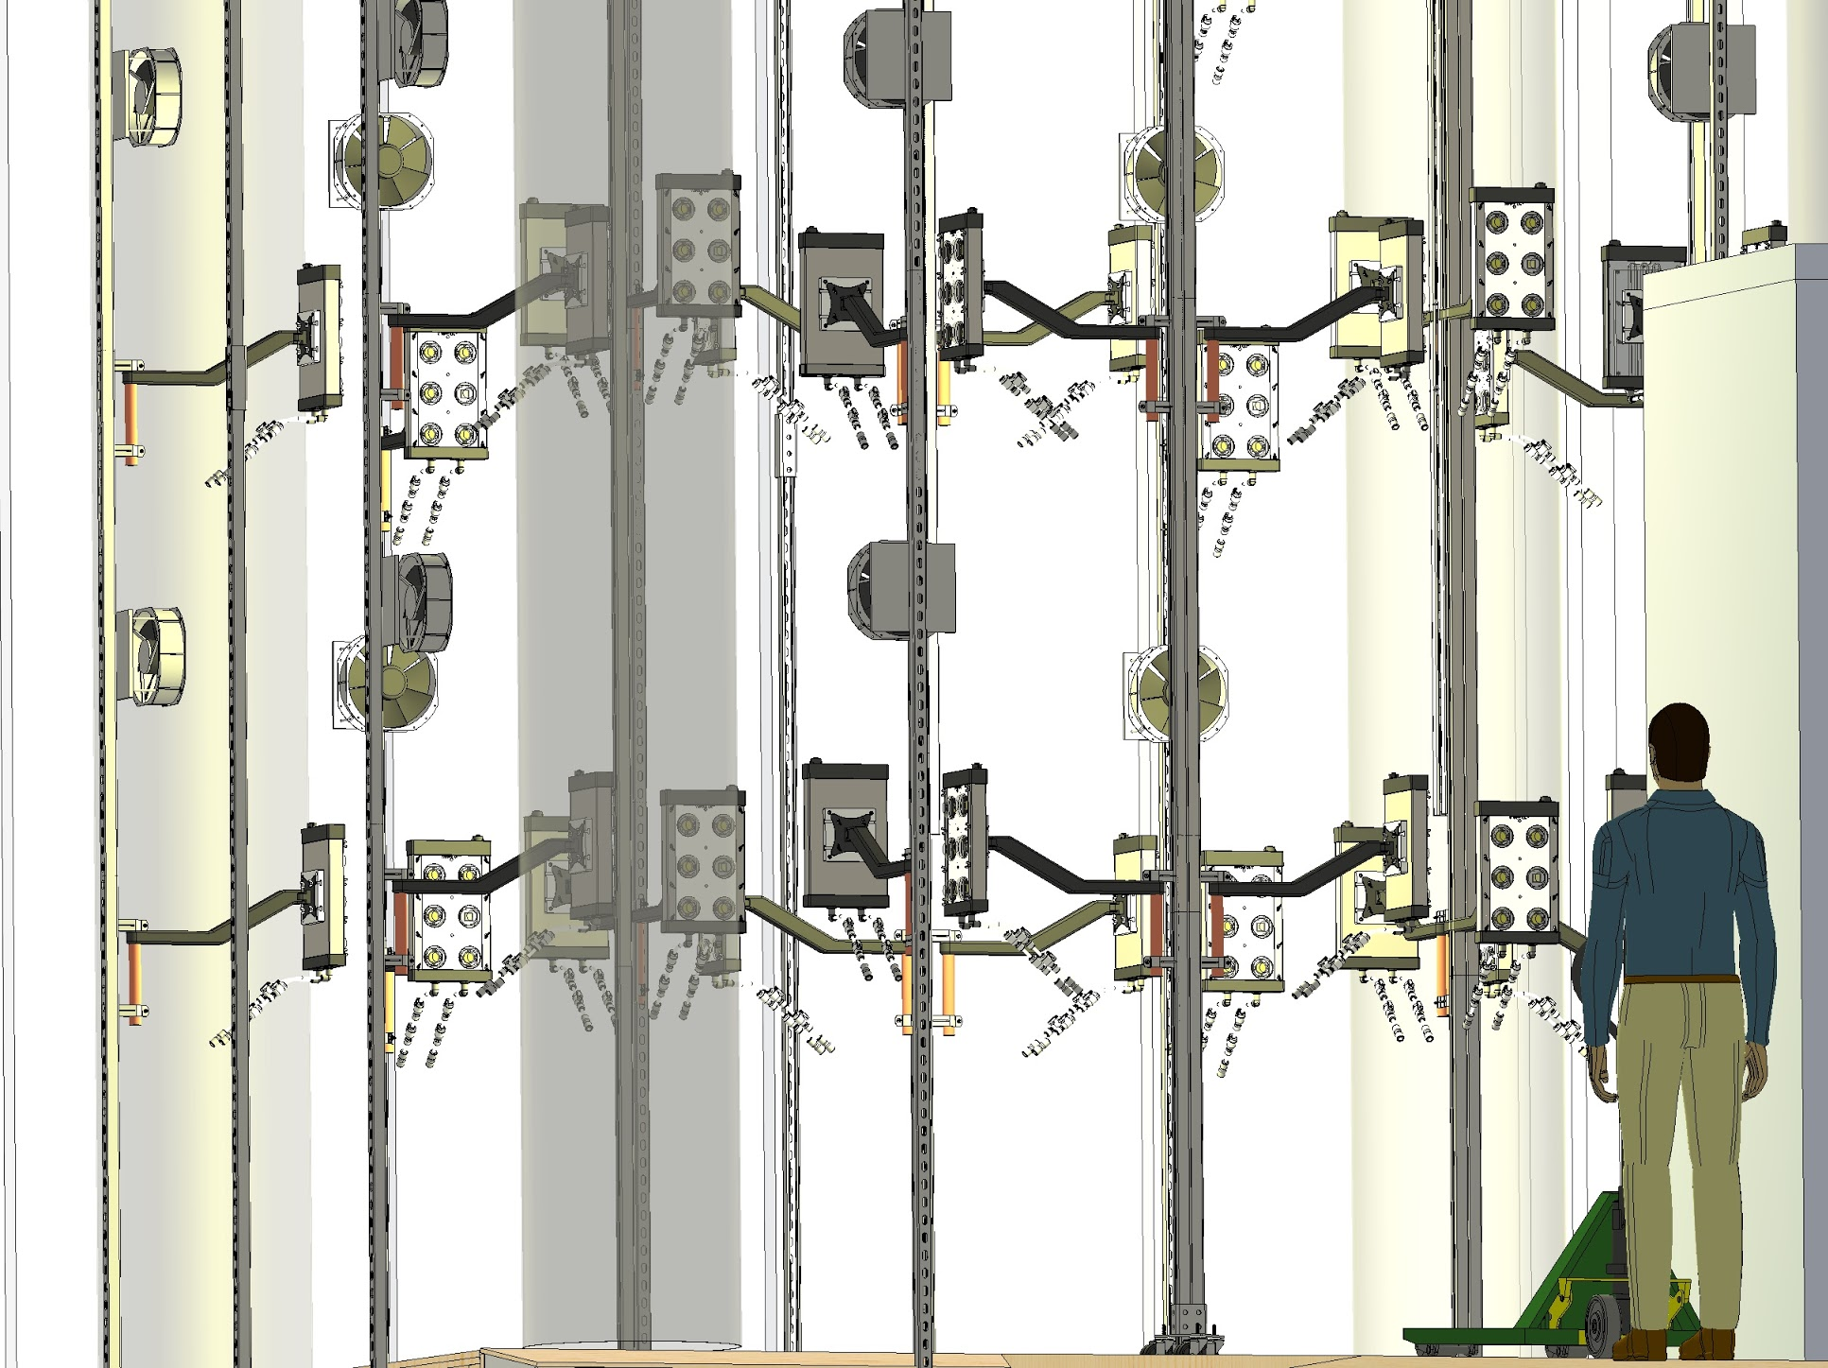

Slide 15
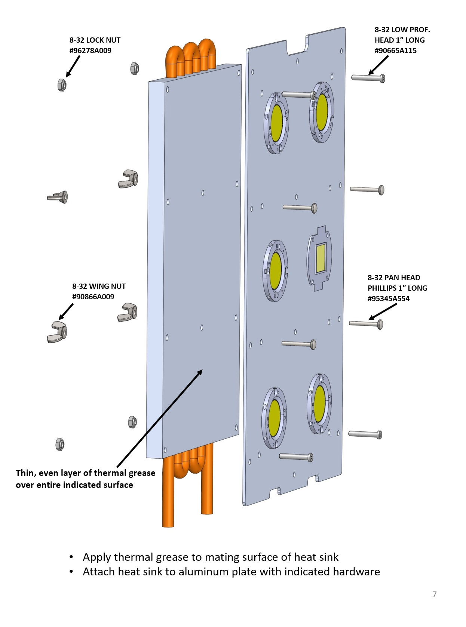
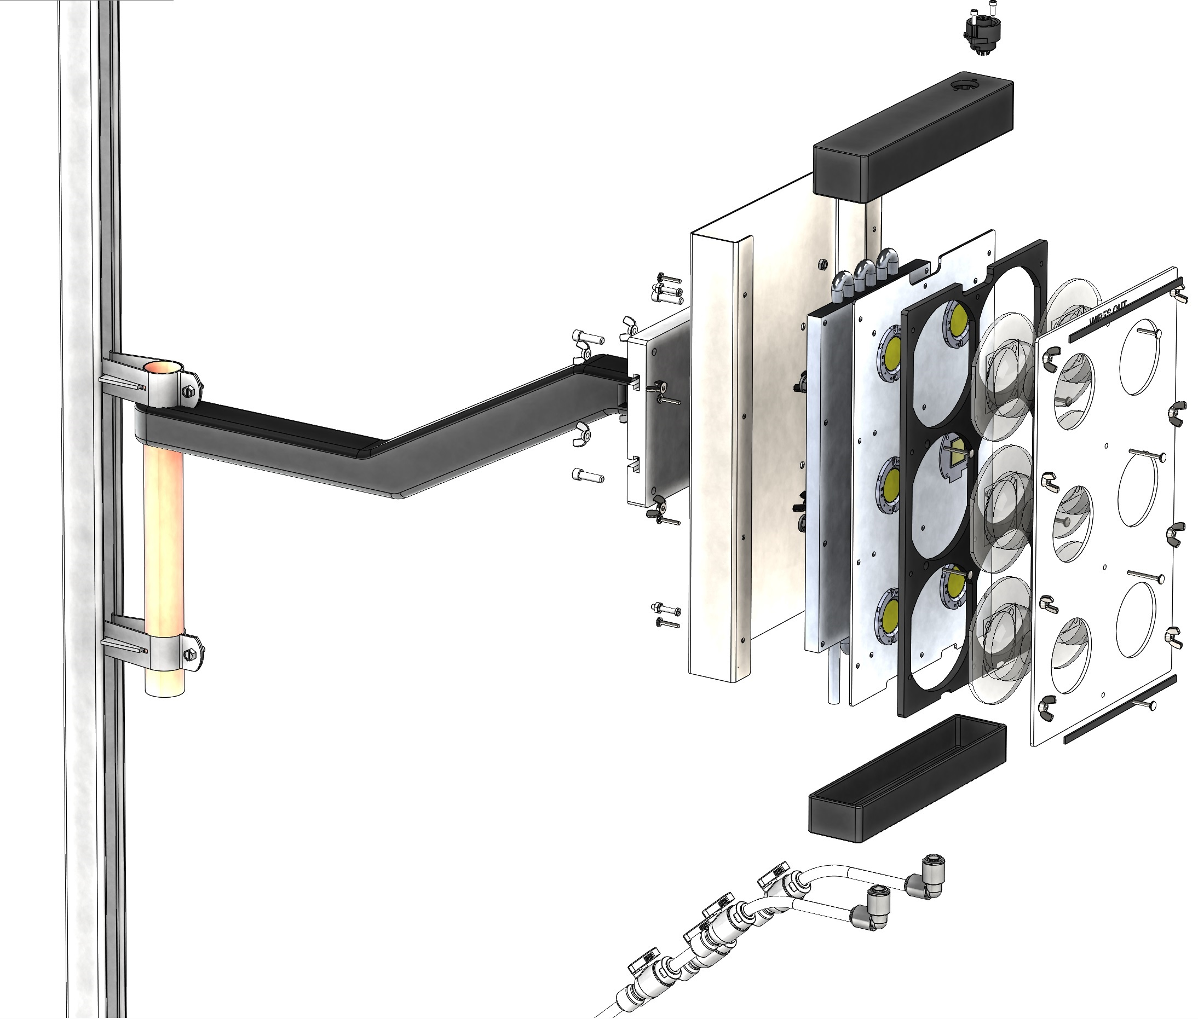

Slide 16
Dehumidifiers (orange) installed; awaiting power;
Evaporators (light blue) installed; awaiting controls wiring & power wiring; awaiting plumbing
Electric Heaters (red) tested and installed;
Humidifiers (dark blue) installed; awaiting plumbing & wiring;
Chillers (light blue) installed; pending refrigerant plumbing & wiring.

Slide 17
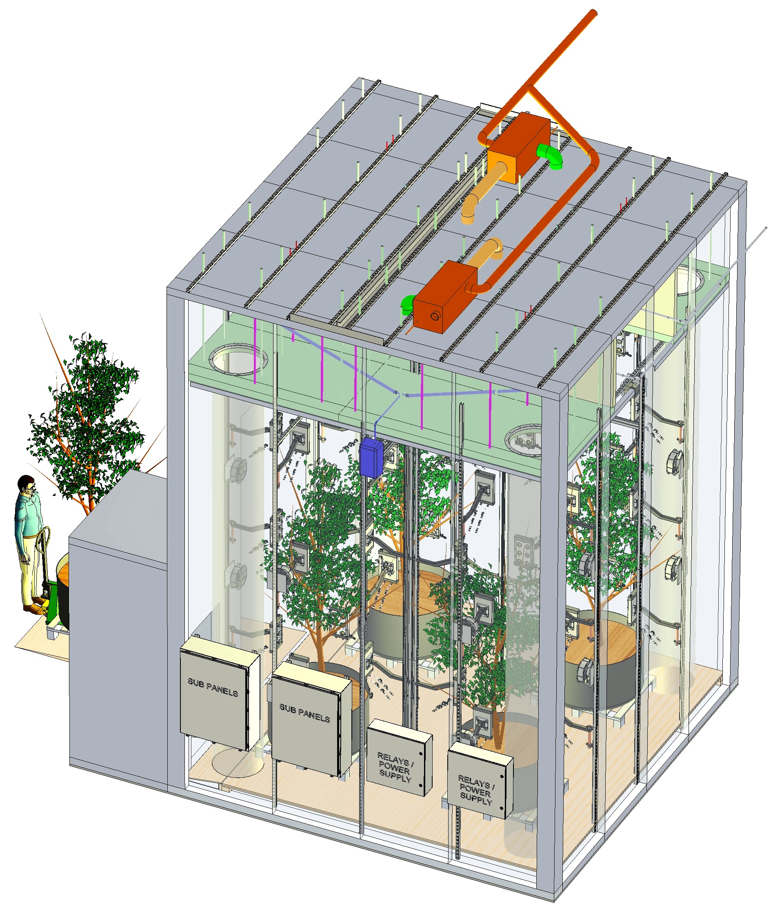
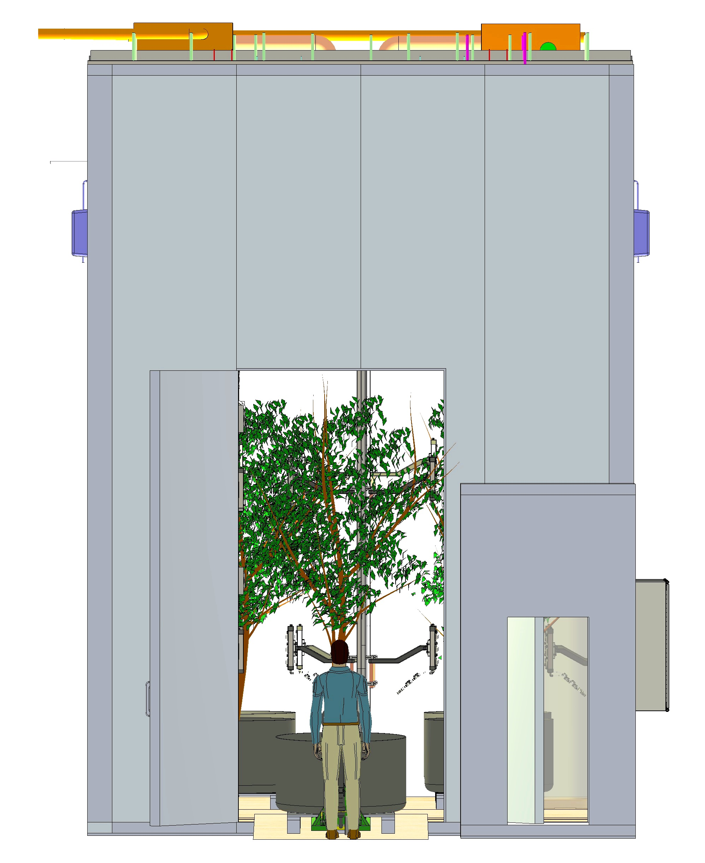

Slide 18
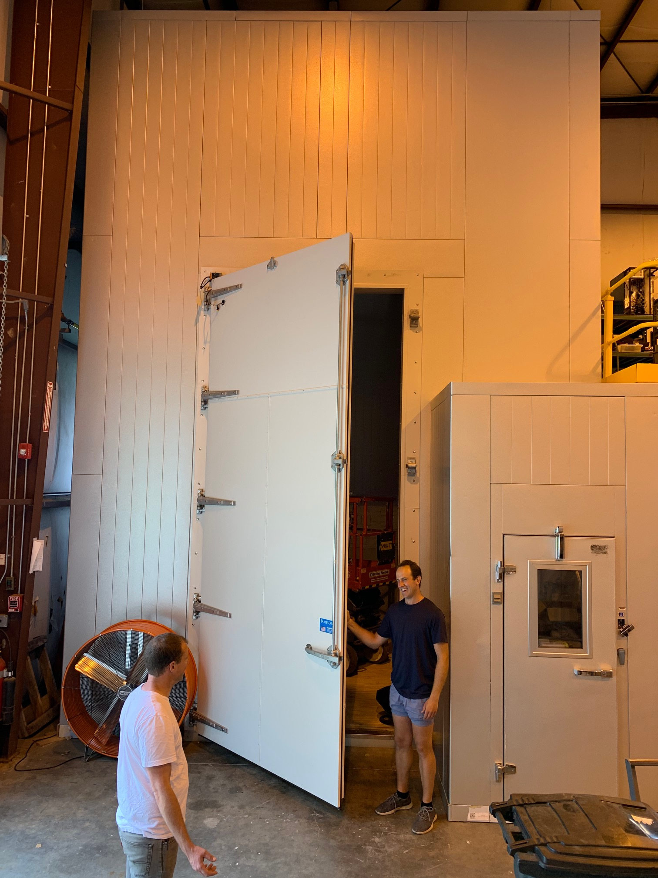
Large Hz Computer
Showing:
5m x 5m x 7m Super-Insulated Enclosure;
4m x 1.8m “Tree Door”;
“Air Lock” with Access Door

Slide 19
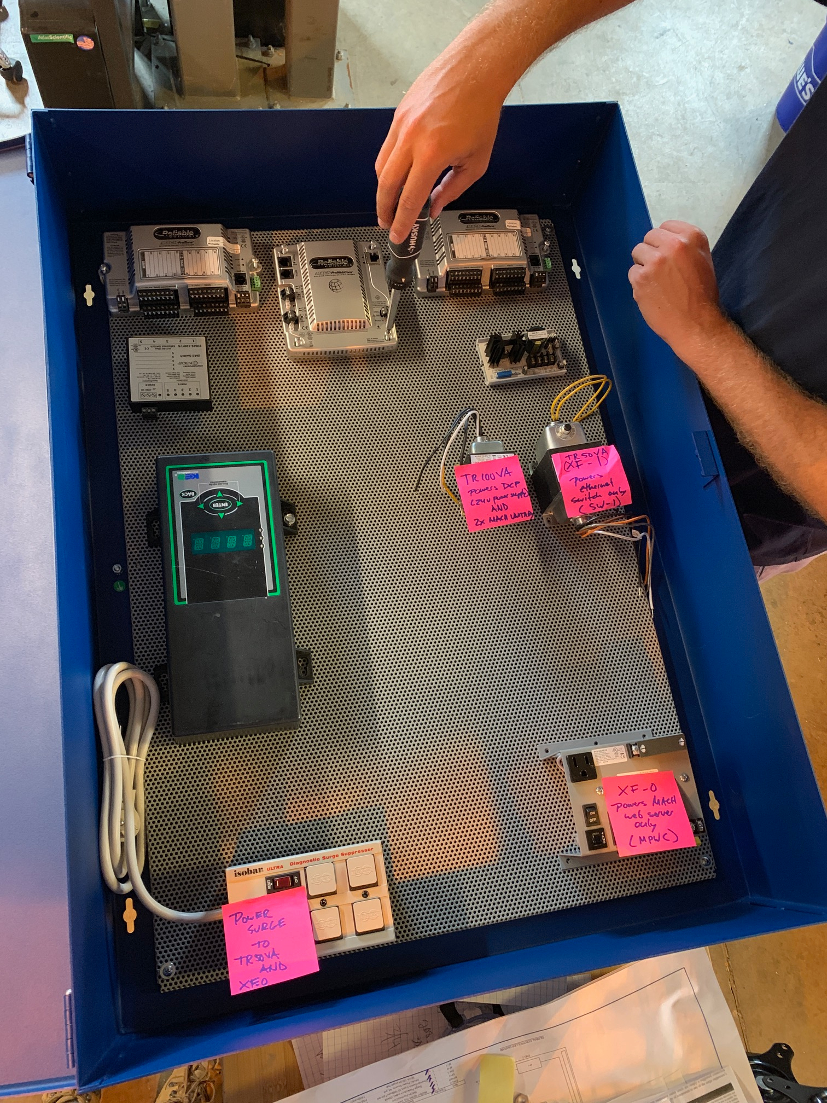
Large Hz Computer “Brain”
Showing:
Global Controller by Reliable Controls (connects to P.C.)
Ethernet Connector
KE2 to control Evaporators & Condensing Units
Power supplies & Surge Protection

Slide 20
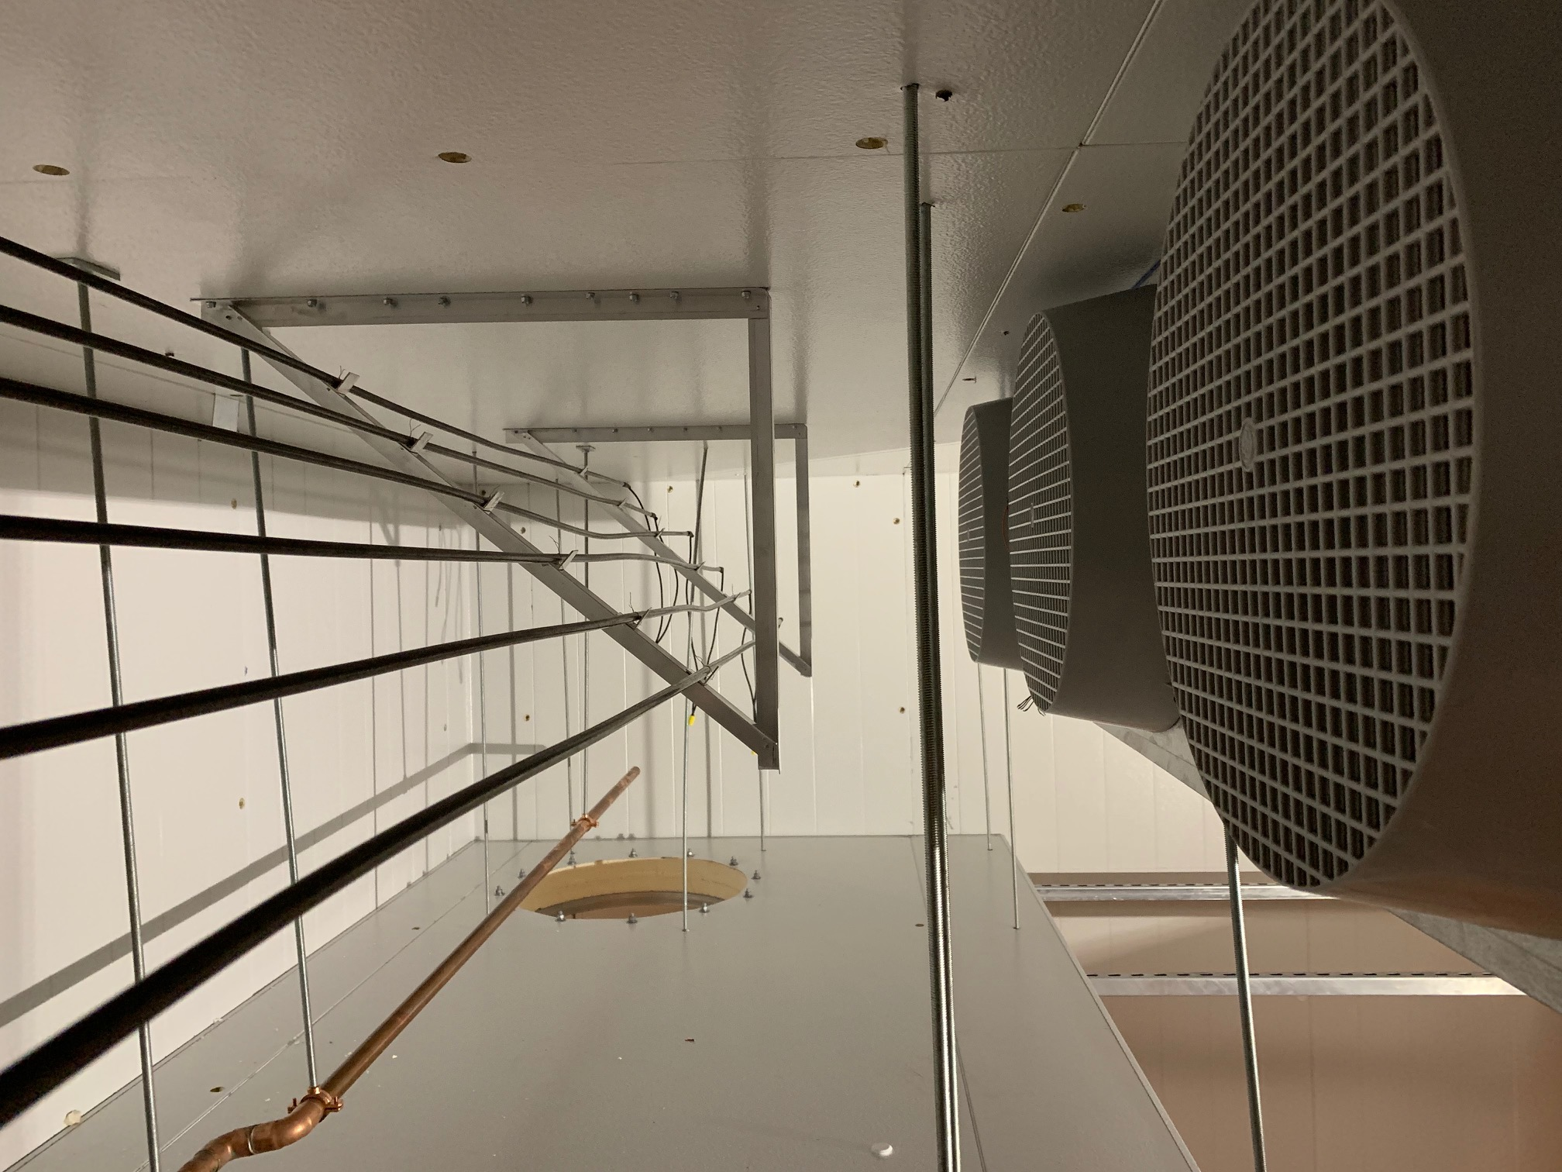
Large Tree Computer Air-Mixing “Plenum”
Showing:
Evaporators (cooling distribution) & Fans
Heater Rack with (6) Resistive Heaters
Humidifier Steam Distribution Pipe
Air Distribution “Duct Sock” Opening

Slide 21
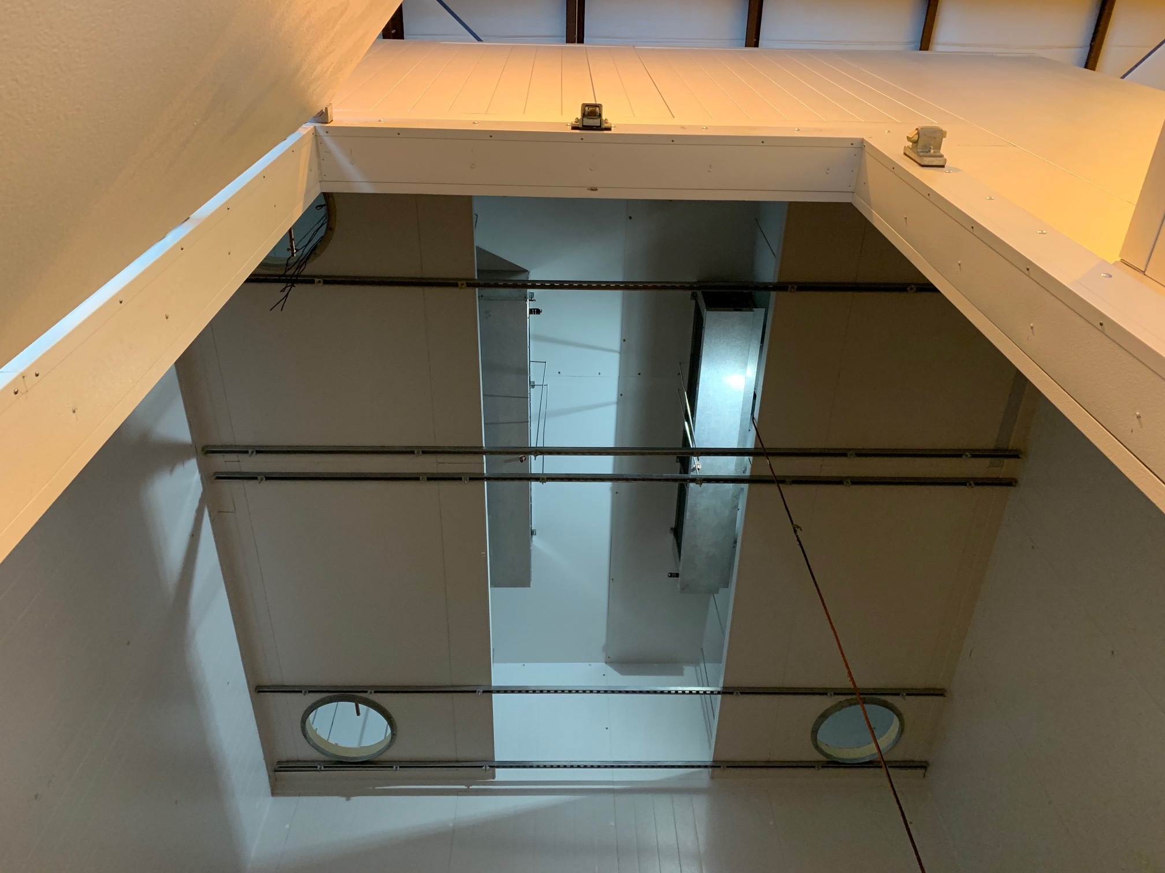
Large Hz Computer
Showing “Plenum” and “Tree Door” from below, including:
1.8m x 4m Tree Opening;
Evaporators (cold air distribution & fans);
Air Distribution “Duct Sock” Opening
Strut-Channel Structural Support / Hangers

Slide 22
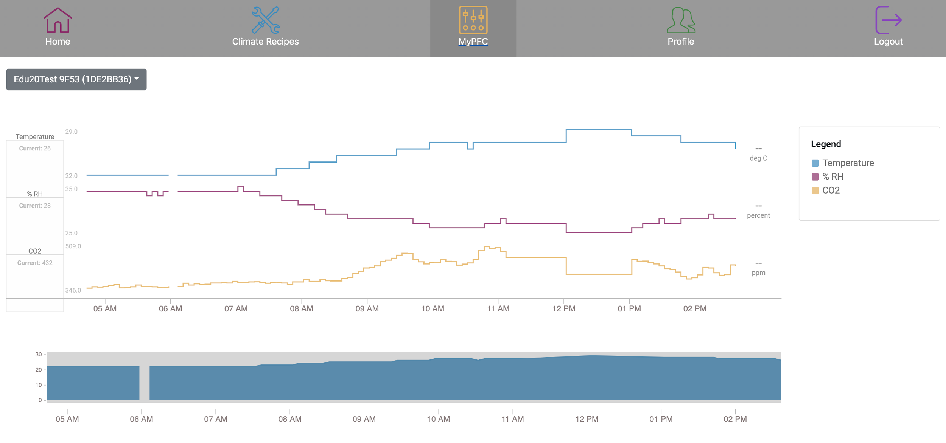
OpenAg Scientific User Interface with Minute-by-minute logging:
Temperature
Relative Humidity
CO2

Slide 23
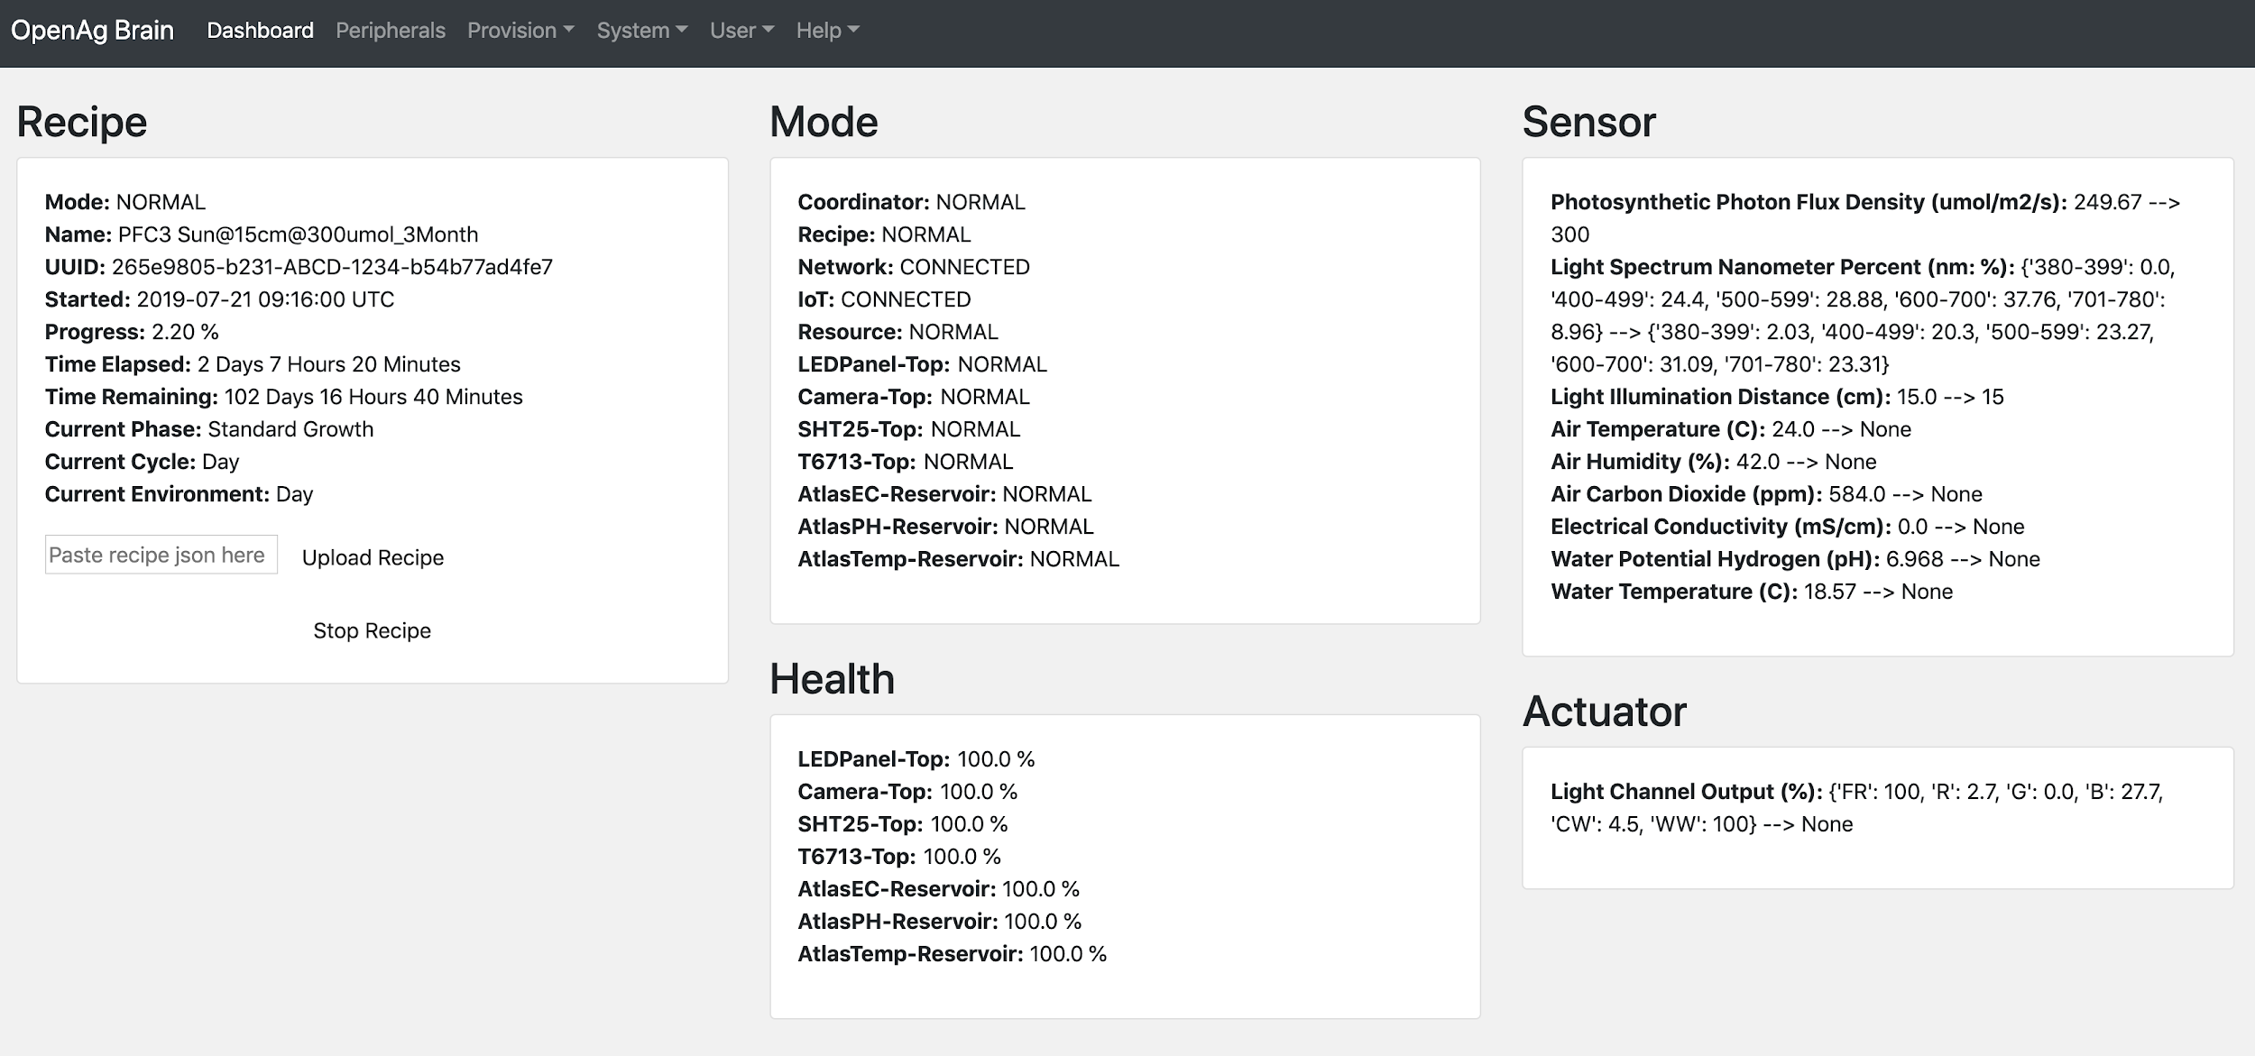

Slide 24
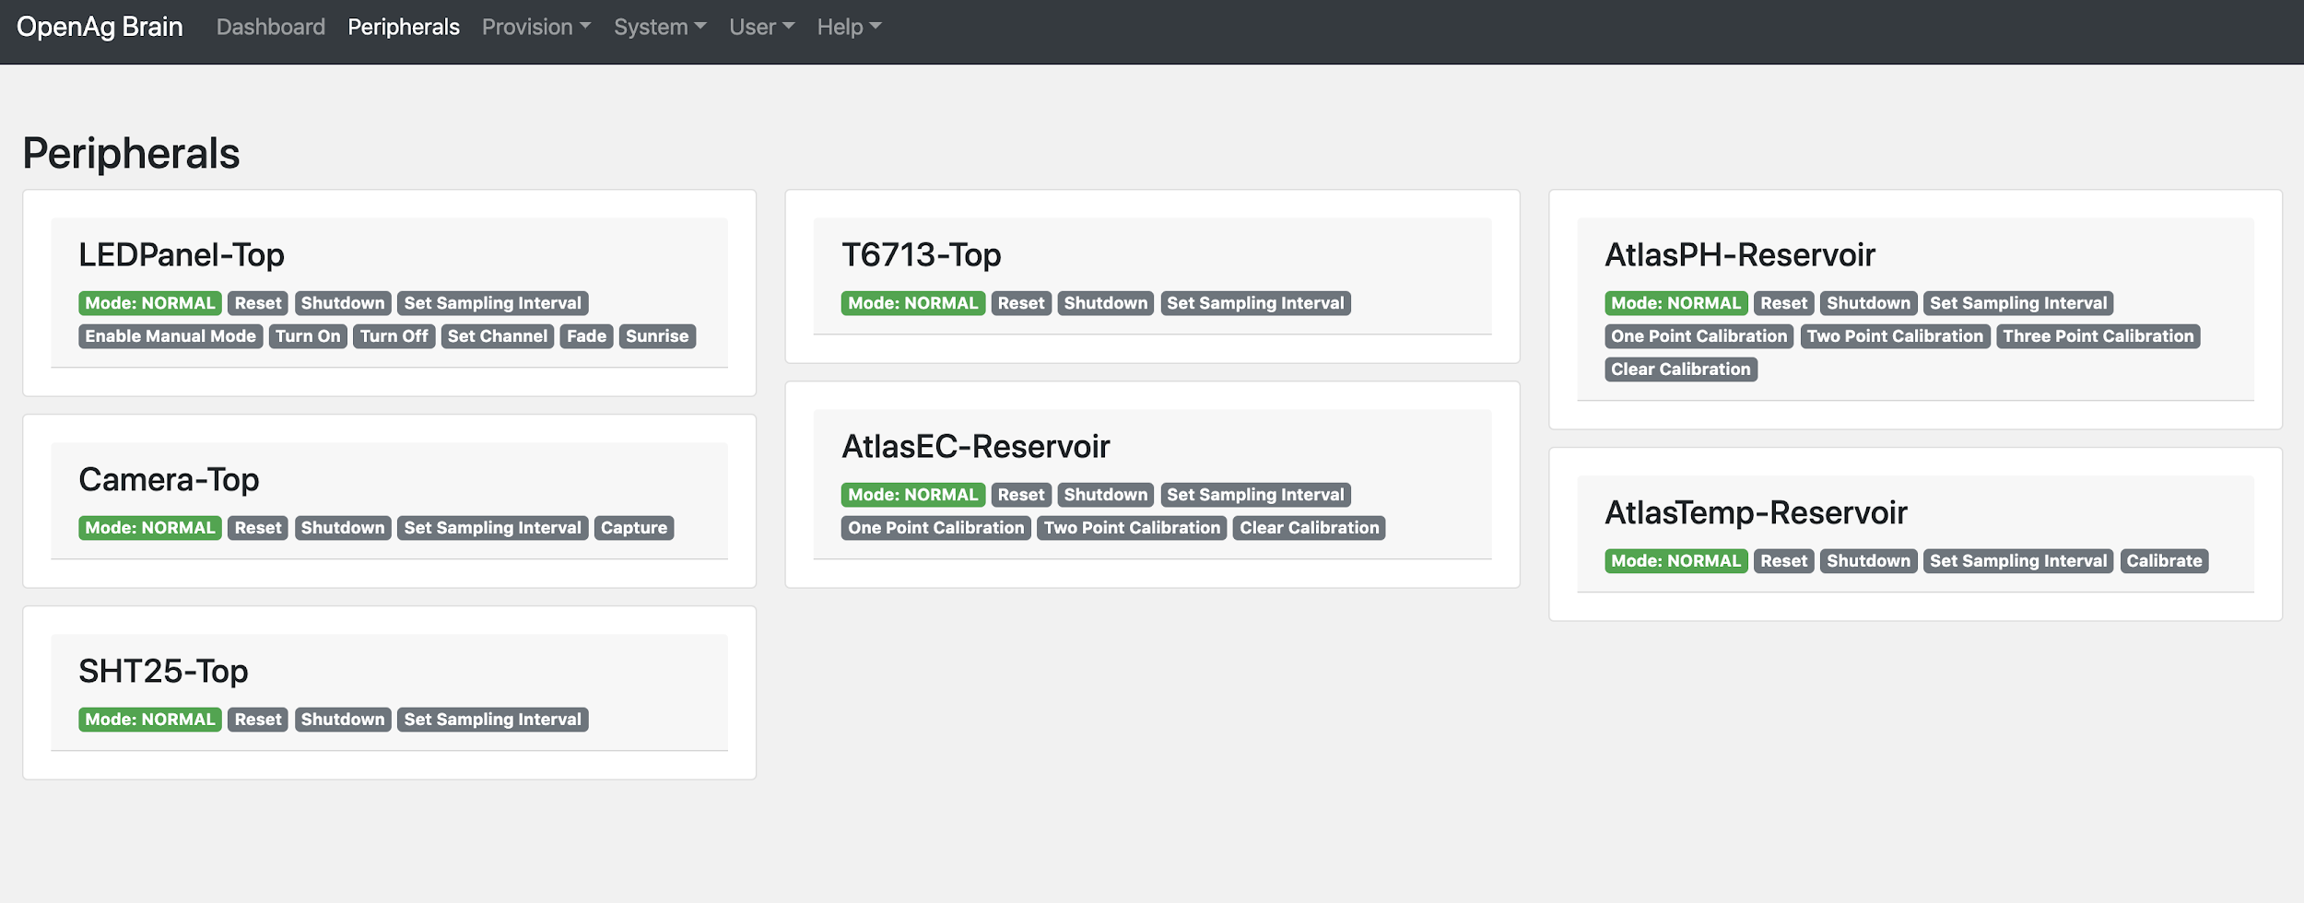

Slide 25
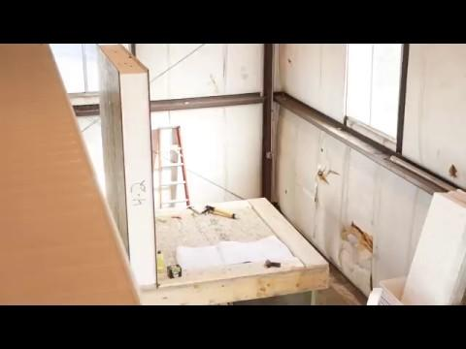
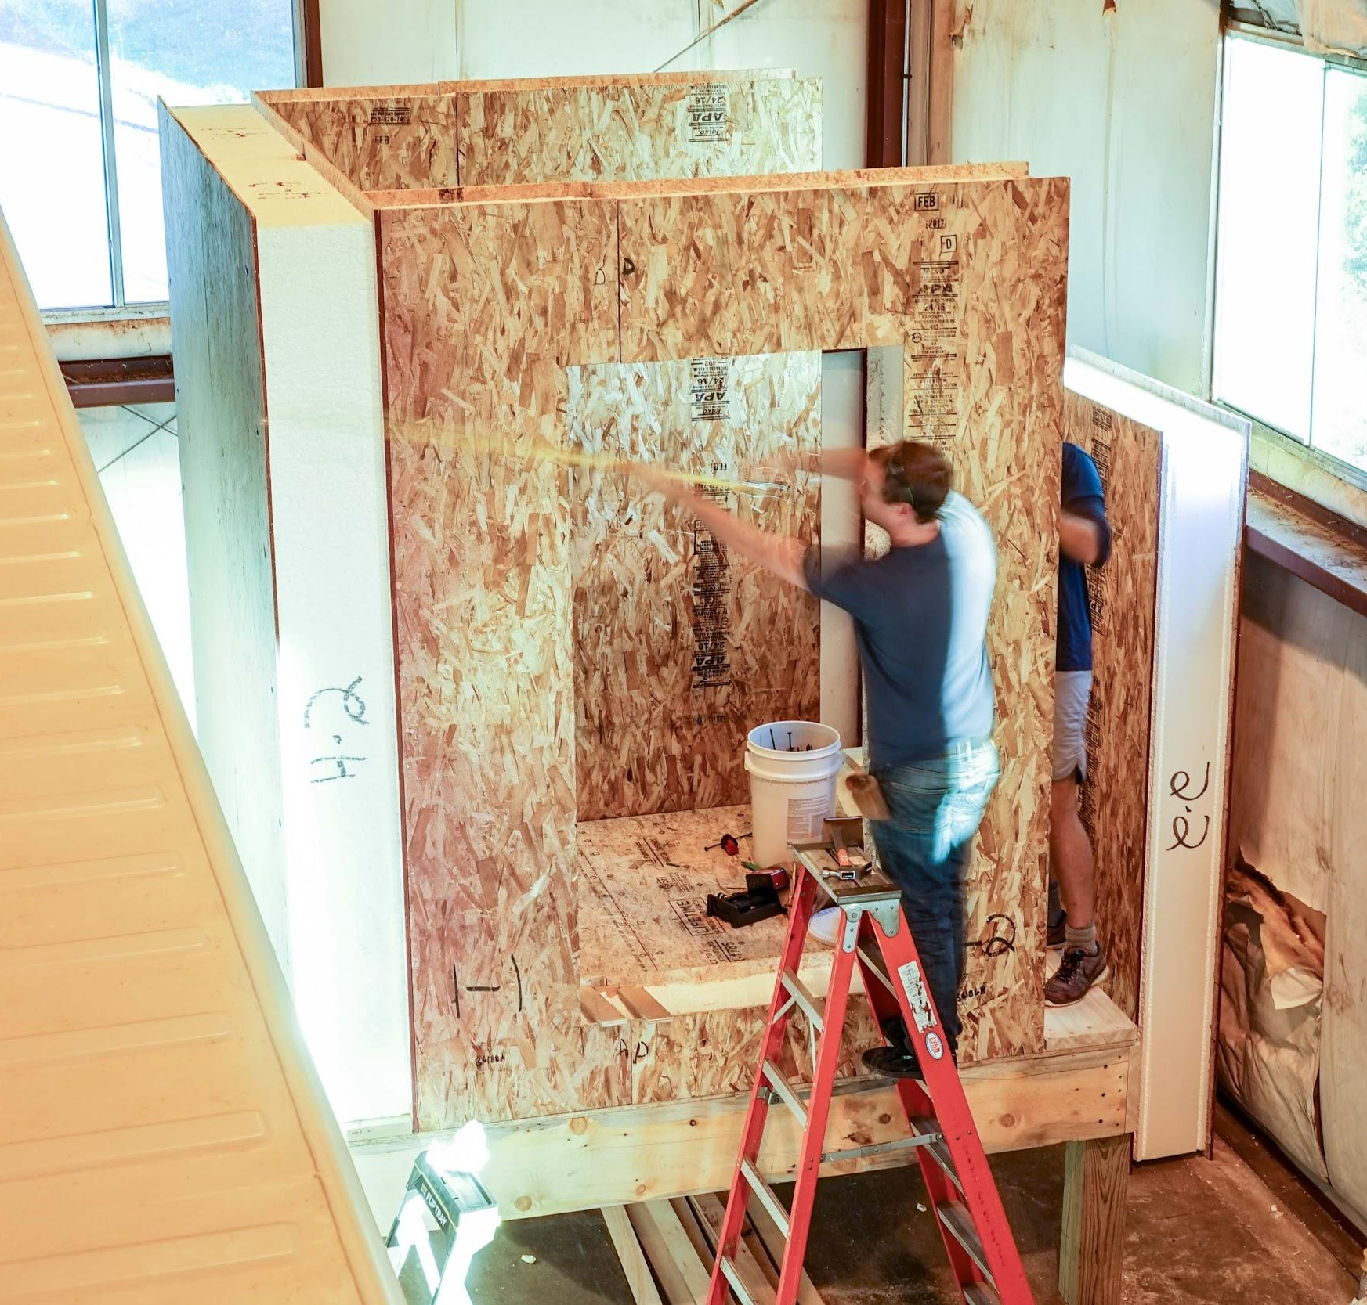
R&D
Modular & light-weight
Super-insulation for -35°C <> 55°C

Slide 26
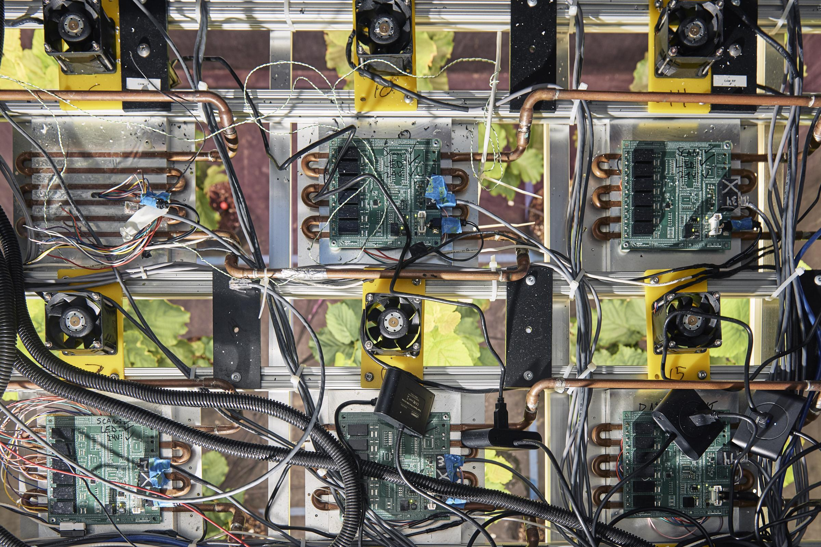
R&D
Irradiance:
97% True-to-daylight
15M+ Combinations
0-1800umol/m^2/s PPFD

Slide 27
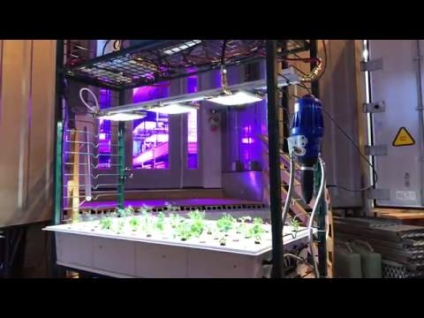
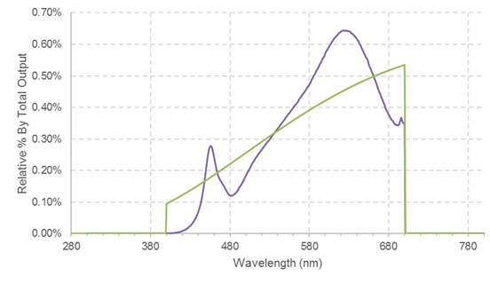
R&D
Irradiance:
97% True-to-daylight
15M+ Combinations
0-1800umol/m^2/s PPFD

Slide 28
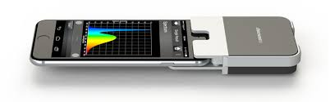
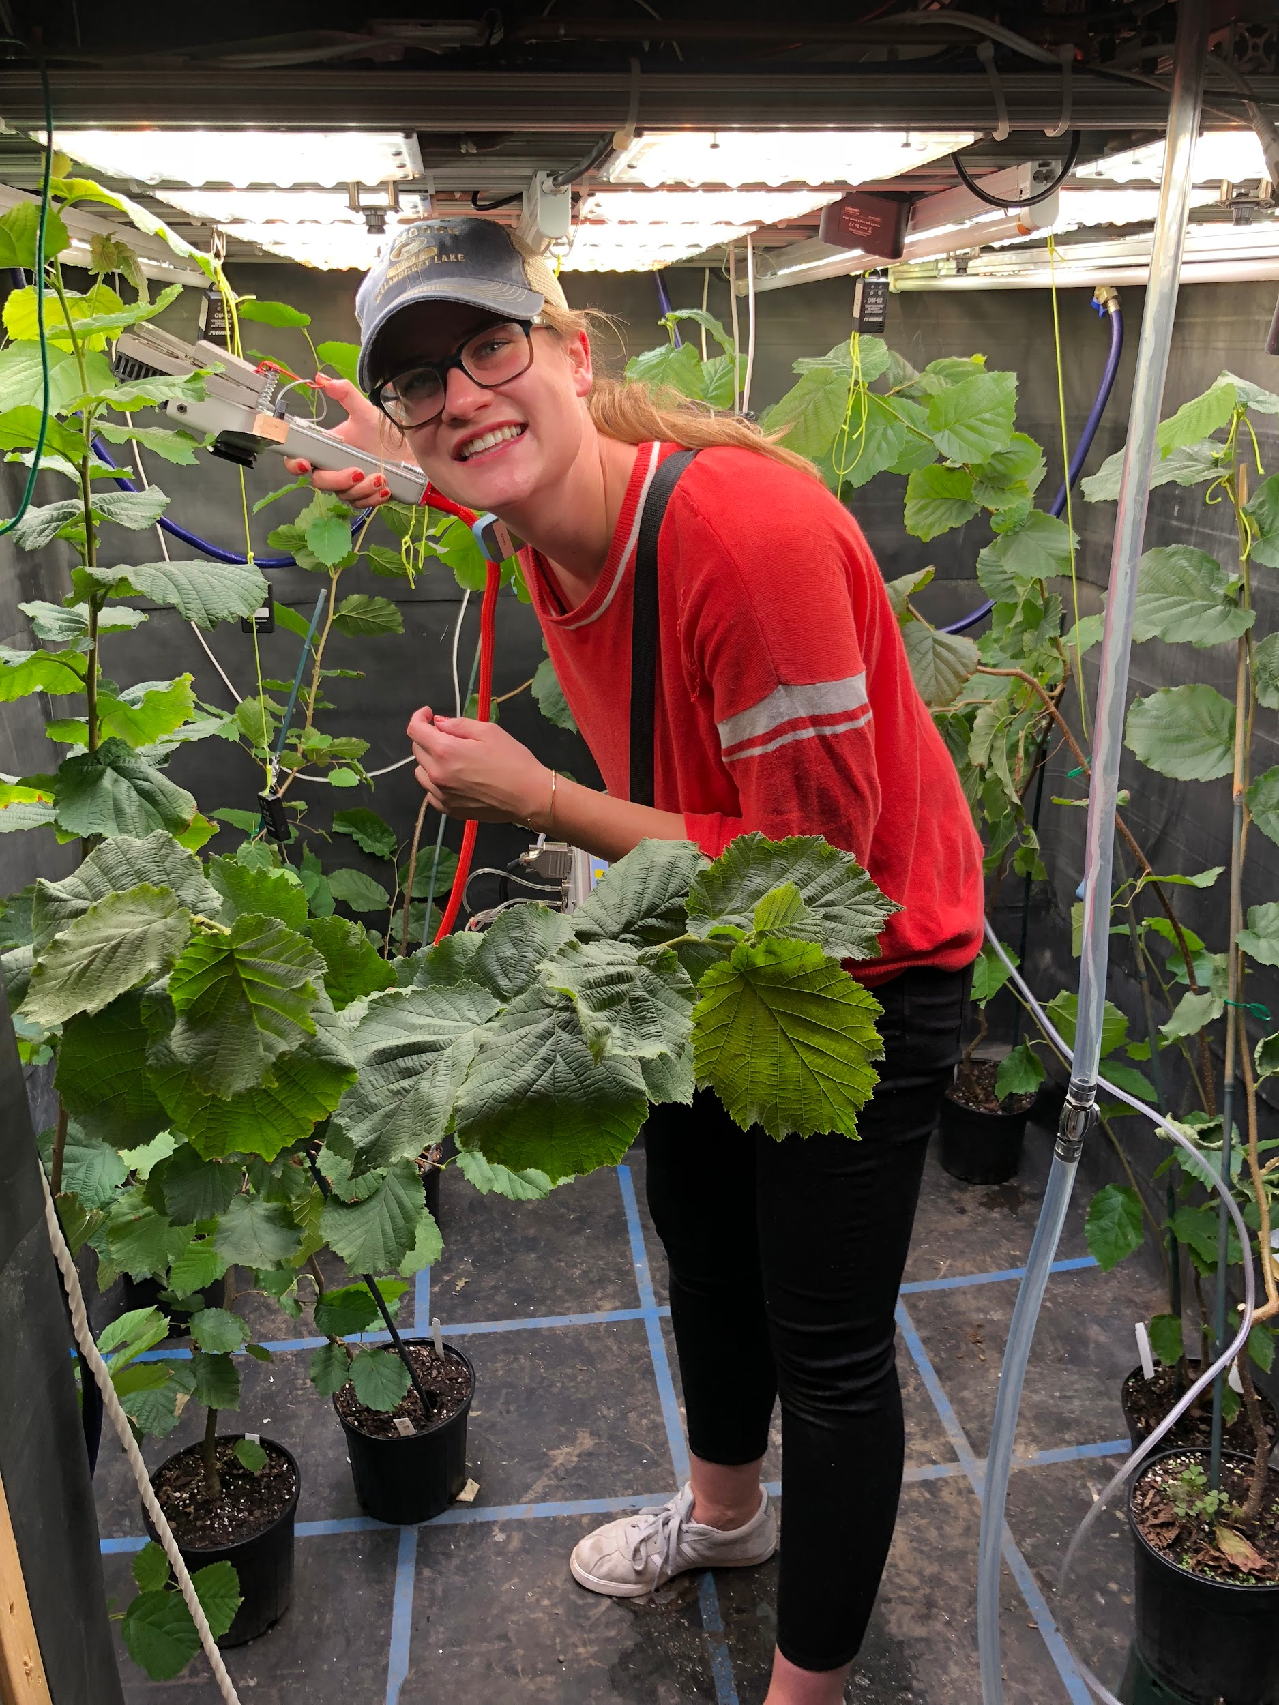
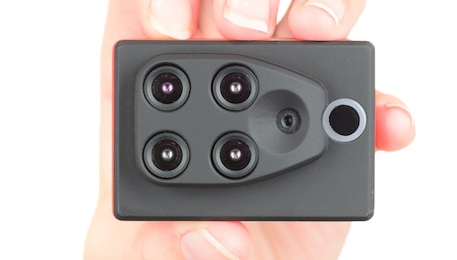
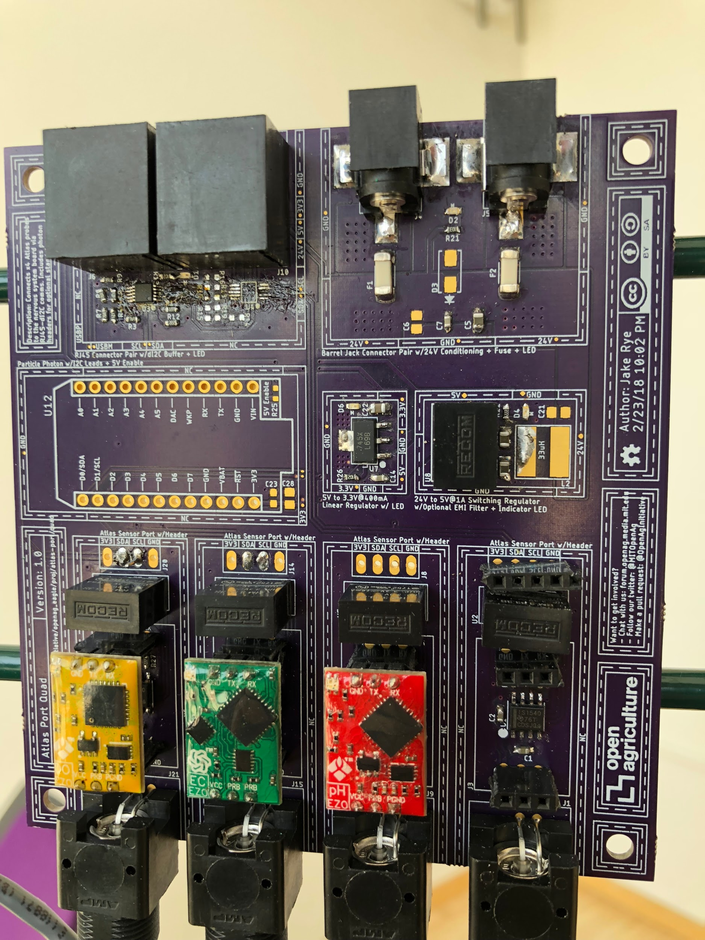
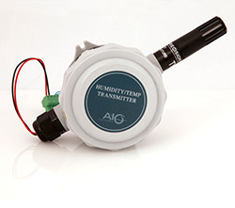
R&D
Tree Computer Sensor Array
Spectrometry
Multi-Spectral Photography
T/RH Meter Array
Lysimetry
Infrared Gas Analysis
Chlorophyll Fluorometry

Slide 29
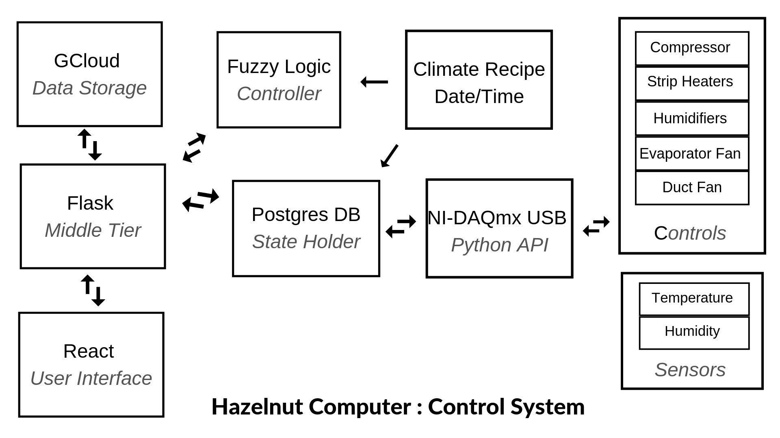
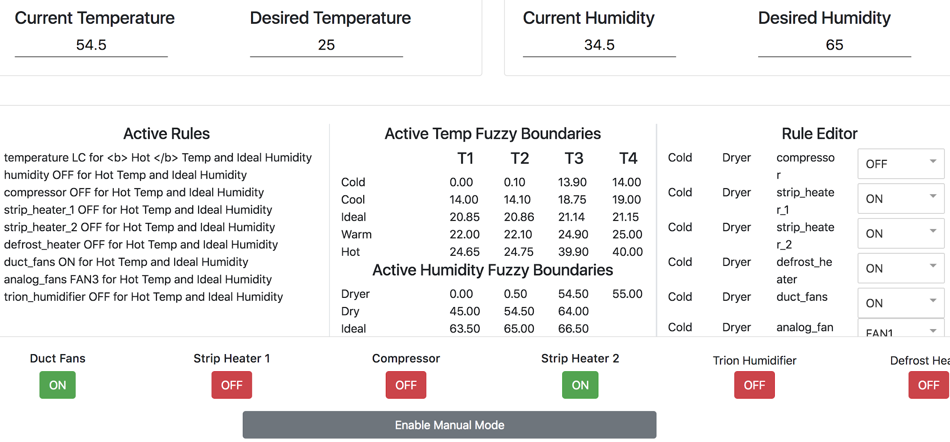
R&D
Software Development: Control Systems
& OpenAg Sci.UI

Slide 30
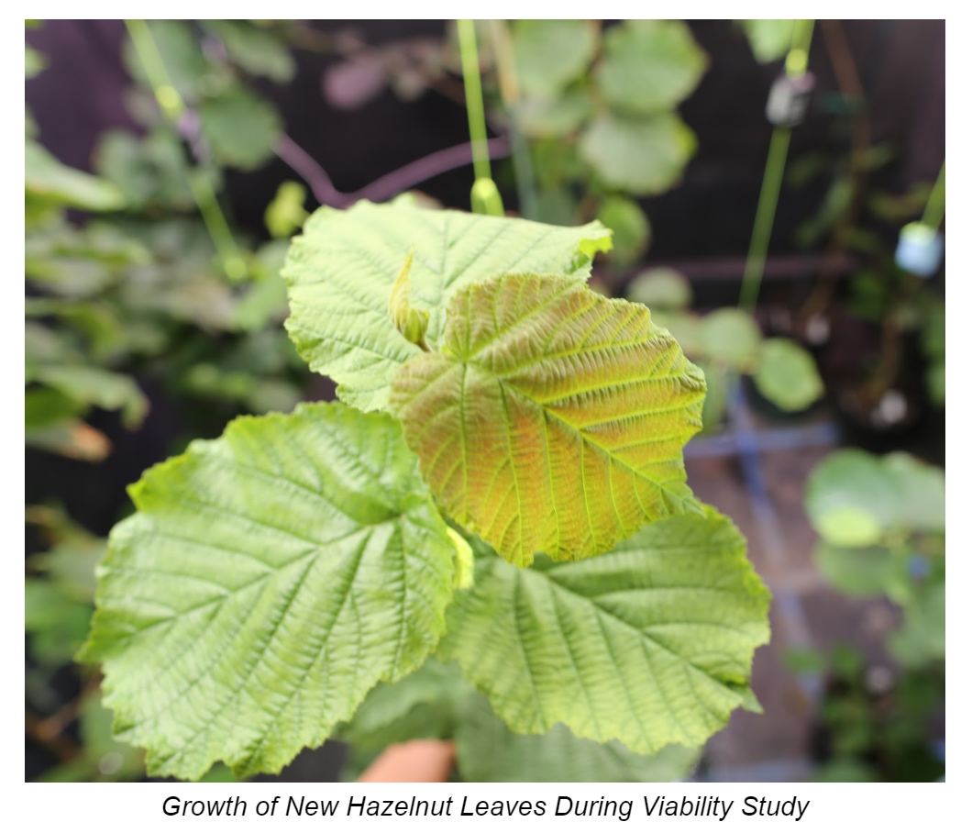
Research & Development
Transplant Trials (“Viability Study”)

Slide 31
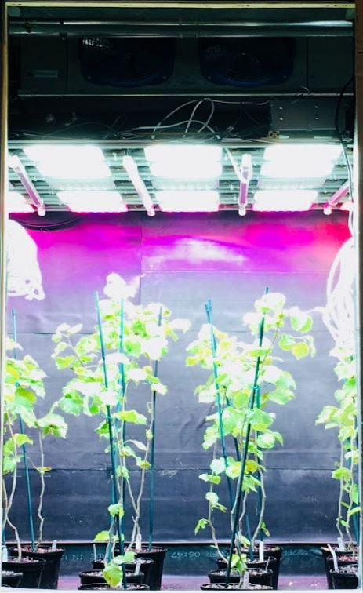
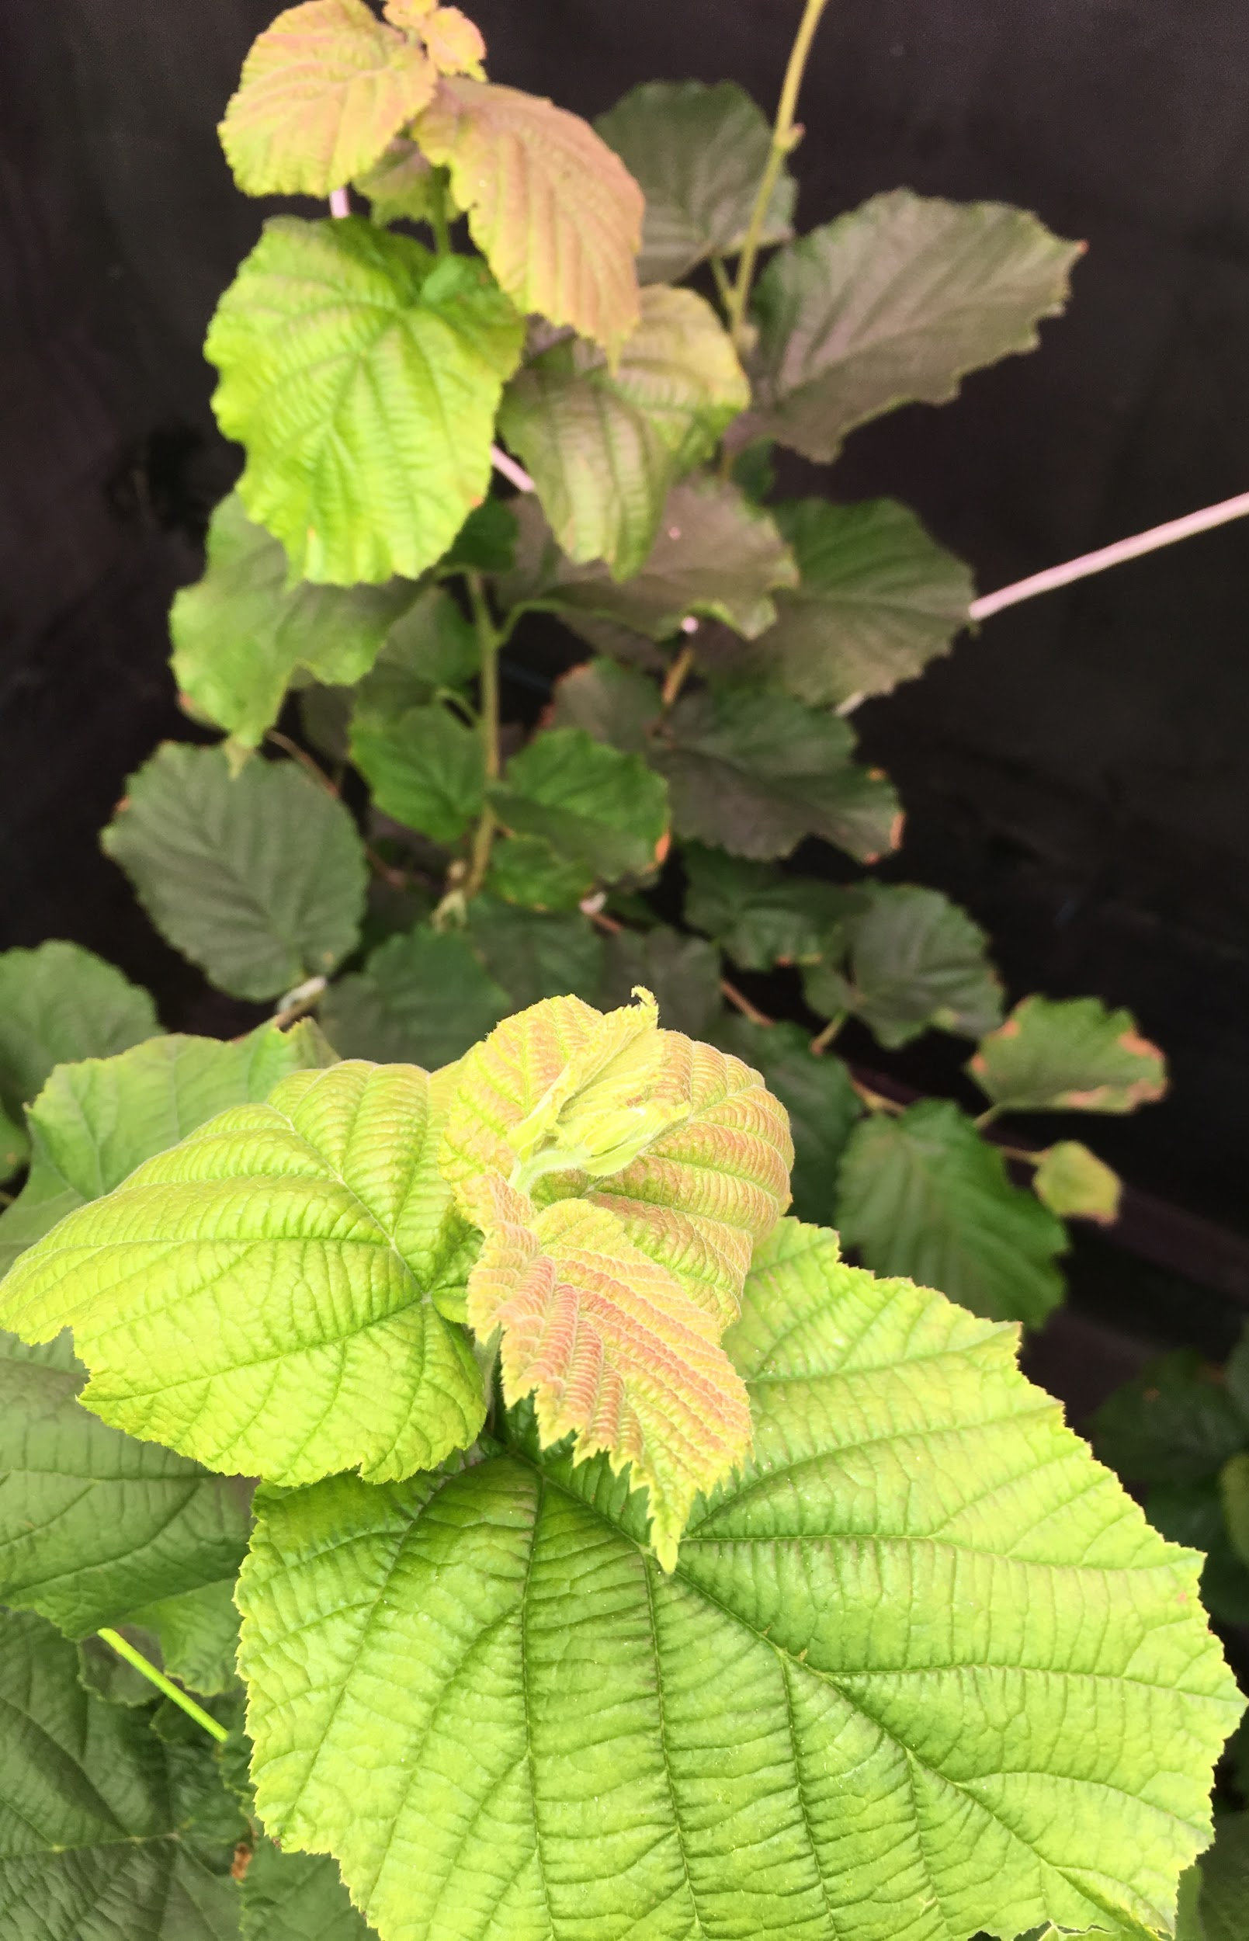
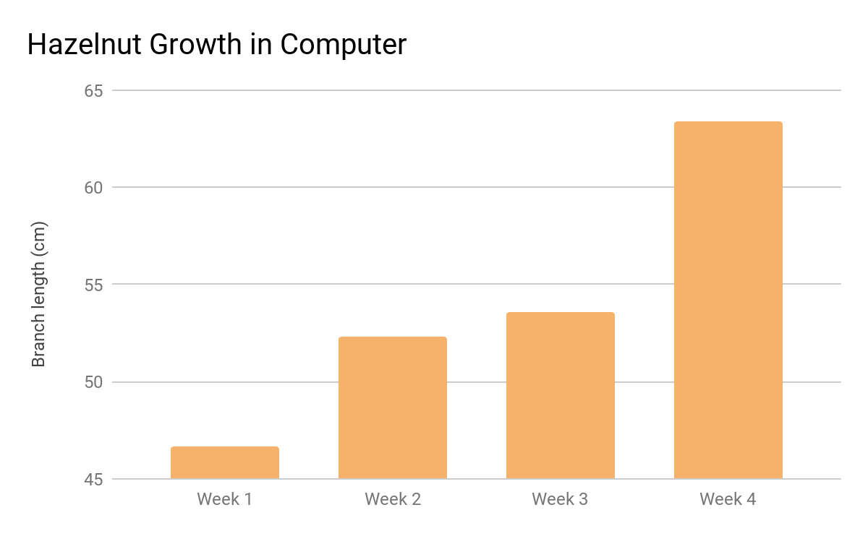

R&D
Transplant Trials (“Viability Study”)

Slide 32

Heat Stress Experiments
T°: 18°C <> 45°C
Rh: 30% <> 65%
Par: 800μmol <> 1600μmol
2018 HIGH AND LOW TEMPERATURES FOR REGIONS PRACTICING HAZELNUT CULTIVATION
LOCATION | HIGH T (C°) | LOW T (C°)
SUBOTICA, SERBIA | 34 | -7
VITERBO, ITALY | 36 | -2
TURIN, ITALY | 30 | -4
BORDEAUX, FRANCE | 37 | -6
TARRAGONA, SPAIN | 40 | -4
SAMSUN, TURKEY | 32 | 0
TRABZON, TURKEY | 29 | 5
NARRANDERA, AUSTRALIA | 44 | -4
KOKSTAD, SOUTH AFRICA | 34 | 5
TALCA, CHILE | 29 | 1
SAN SEBASTIAN (VALPARAISO), CHILE | 34 | -2
CHATHAM-KENT, CANADA | 34 | -22
NEW BRUNSWICK, NJ, USA | 34 | -20
EUGENE, OR, USA | 36 | -6

Slide 33

Heat Stress Experiments
T°: 18°C <> 45°C
Rh: 30% <> 65%
Par: 800μmol <> 1600μmol

Slide 34

Correlation Test:
18°C - 25°C
65% RH

Slide 35


Heat Stress Experiments
T°: 18°C <> 45°C
Rh: 30% <> 65%
Par: 800μmol <> 1600μmol

Slide 36


Cold Stress Experiments
T: -10°C <> -35°C

Slide 37

Cold Stress Experiments
T: -10°C <> -36°C

Slide 38


Cold Stress Experiments
T: -10°C <> -35°C

Slide 39



Cold Stress Experiments
T: -10°C <> -35°C

Slide 40



Cold Stress Experiments
25% BUD DESTRUCTION (LT%)
WEPSTER
YAMHILL
MACDONALD

Slide 41



Cold Stress Experiments
50% BUD DESTRUCTION (LT%)
WEPSTER
YAMHILL
MACDONALD

Slide 42




Herbivory, Nutrient Depletion,
& Mineral Toxicity Experiments

Slide 43

Plant Chemotyping @ Sm HC
Chemotype Selection & Recycling Trimmings

Slide 44

Data Sharing
Networked Tree Computers

Slide 45

Tree Computer
Nursery <> Tree Computer <> HQs Work Flow

